Slide 1
The CEAFRE MODEL
Centre of Excellence in Agri Finance and Rural Entrepreneurship (CEAFRE)
www.ceafre.org.pk
Email:info@ceafre.org.pk

Slide 2
CEAFRE: A Holistic Approach to Agri-Finance
The Centre of Excellence in Agri Finance and Rural Entrepreneurship (CEAFRE) is Pakistan’s pioneering effort to bring together the best minds in the agricultural, financial and entrepreneurial experts to solve the most pressing problems plaguing rural communities seeking to modernize their agri-sector in a socially and environmentally responsible manner.

Slide 3
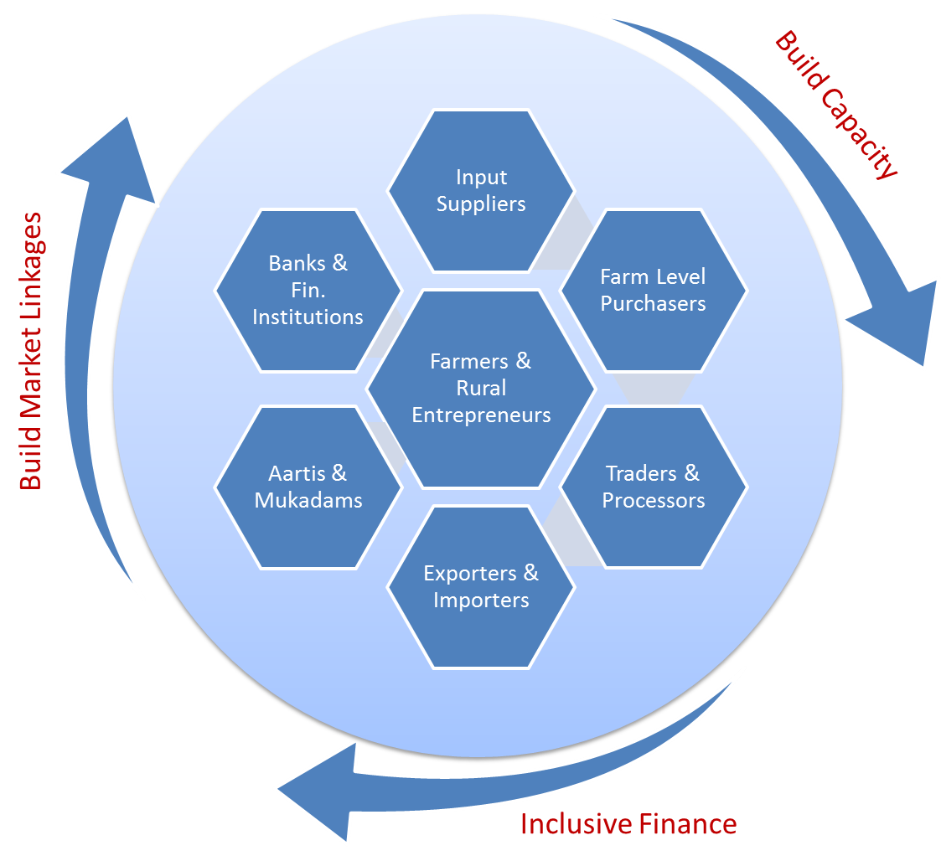
CEAFRE: The Model Explained
CEAFRE has been setup to enable a supportive ecosystem for the ‘rural entrepreneur’ - a person who sees an opportunity in their rural economy and has the drive and determination to pull together the resources, people, ideas and strategy to pursue it.

Slide 4
CEAFRE: Planned Interventions
Capacity Building
Training in ‘farming techniques & agri-best practices
Financial Inclusion
Financial Literacy
Improving access through lending capacity building of banks and financial institutions
Market Linkages
Identifying & tapping into domestic and international suppliers & purchasers
Providing risk mitigation through buying agreements that can be collateralized for access to loans
Expertise in crop evaluation & rotation
Irrigation, water harvesting, bio-remediation & alternate energy
Building collectives and maximizing economic benefits
Identifying and mitigating barriers to financial access at a macro-level
Advising on development of financial lending tools
Digitizing payment methods
Identifying and developing agri value chains
Building academic & research networks for nurturing these clusters

