Slide 1
Innovations to insure agricultural catastrophic risks
Dr. Emilio Hernandez
Agricultural Finance Officer, AGS
Islamabad, 28-29 April 2015
SBP-FAO Conference on Innovative Agricultural Financing

Slide 2
Content
The catastrophic and non-catastrophic agricultural risk layers to insure
Lessons from policies fostering smallholder insurance covering these types of risks
Visions forward for agricultural insurance in developing countries
Conclusions

Slide 3
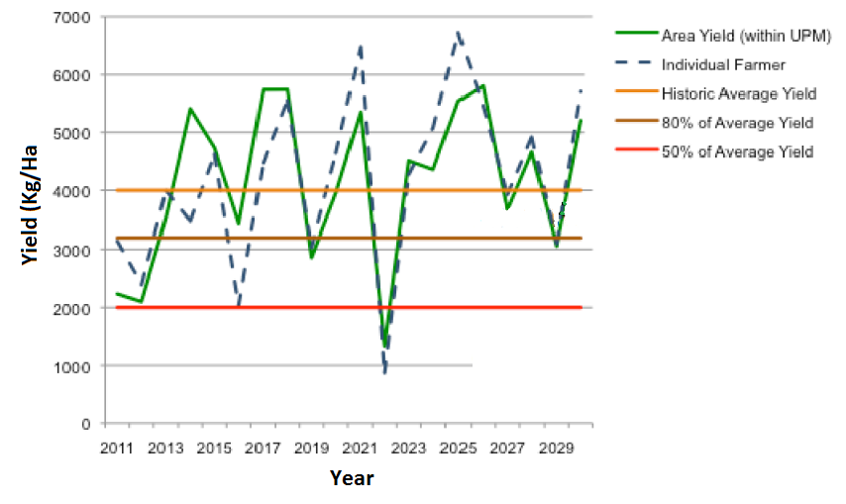
Insuring catastrophic and non-catastrophic risks
Self-coping risk layer
Commercial risk layer
Catastrophic risk layer
Source: Adapted from Carter et al. 2014
Notes:
The best form to define catastrophic and non-catastrophic risk is by looking at an example of what a smallholder household would face. These are estimated yields of rice farmers in coastal Ecuador using historical yield records. So we have low productivity levels. By studying farmers it is reported that when yields are above 80% the historical average, farmers are able to cope with the shock through their diversified activities and would not want to pay for insurance. But when yields are between 80% and 50% the historical average they would suffer and default on loans and other commercial commitments in order to meet their family needs. Here they would be willing to pay for insurance given that with an indemnity they would be able to cope with their commercial obligations. But if yields are below 50%, the damage would be so high that the family would not be able to meet its basic needs much less its commercial obligations.
The insurance product is conceptually the same for catastrphic and non-catastrophic insurance, but the indemnity must be significantly different. Say an area yield insurance is offered and the correlation of the index is reflected in the green line. Basis risk would imply that during the time observed, only in one occasion the insurance policy would not pay the client when it actually needed to pay. This is in 2015.

Slide 4
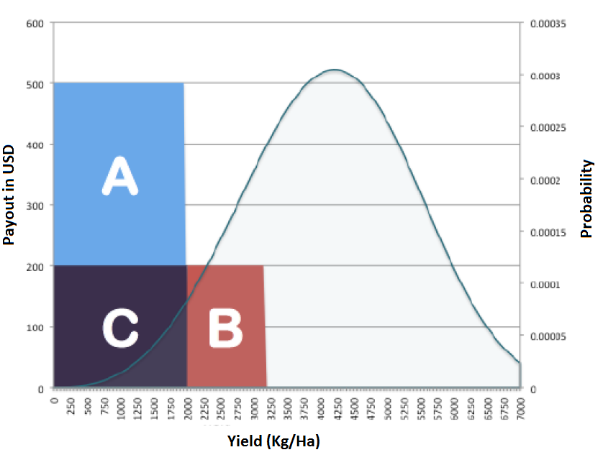
Segmenting insurance product by risk layers
Source: Adapted from Carter et al. 2014
Notes:
Insuring a commercial risk layer implies offering a payout that would reimburse the client’s working capital (say financed through a loan) and some of its investment lost. Say this would be USD200/Ha. This indemnity payment would be reflected by B. The price of this policy would be the actuarially fair price (expected loss of USD200 * probability of occurring of 0.06 = USD12/Ha) plus the insurer service fee (say 25%), that would be USD15/Ha.
But insuring the catastrophic layer implies offering a payout that would reimburse not only the working capital and partial investment (shown by C) but also covering the family basic needs during the recovery period (shown by A). Say this implies a USD500 payout.
The challenge is that catastrophic risk implies knowing the probabilities that are at the tail of the distribution, which in practice are very hard to estimate with good confidence given that the poor available data in developing countries is particularly bad at capturing extreme events. Given that also the payouts are significantly higher, the insurance industry is much more conservative in pricing such policies if even offered.

Slide 5
Some recent lessons on agricultural insurance
Catastrophic insurance has been the hardest to promote given that the systemic nature of events and higher expected loss result in market concentration. And the scarce data results in very high pricing relative to non-catastrophic insurance. This has called for government intervention.
Conventional insurance with indemnity payments against verification of losses does not work for smallholder farmers due to prohibitive costs
Experience accumulated with index insurance shows on low adoption rates among clients and distribution models that depend on subsidies
Basis risk as one of the main challenges of index insurance in the developing world. There is lot of innovation on this front with new ways of using technology for product design (e.g. remote sensing) and distributing index-insurance (e.g. through aggregators that insure portfolios). But results are to be seen.
The demand for ag insurance increases with the client’s ability to manage non-insurable risks Clients face many risks that are non-insurable related to production and commercial risks in agro-ventures. Other financial tools are better to manage and cope with those risks (credit, savings, transfers) in addition to enhanced production technology.
Notes:
Low adoption rates. The well document cases of Malawi (Giné 2009) and India (Cole et al 2013) show adoption rates of 20-30%, with farmers hedging very low income levels.

Slide 6
Example – Policy innovations to deal with catastrophic risk
Mexico – The case of CADENA
CADENA is a social safety net programme specific to support poor smallholder farmers in case of a catastrophic event. For this, the State Governments buy catastrophic agricultural insurance from insurance companies to cover vulnerable areas. This created a market for catastrophic insurance that did not exits and sparked the development of insurance products unique for each region in Mexico.
Federal Government
80-90% of premium
10-20% of premium
Public insurance company
State Government
Private insurance companies
Cash transfers in case of event
Indemnity for area insured
Eligible farmers in insured areas
Source: FAO, 2014
Notes:
States governments buy an insurance policy to cover areas they choose within the State. If there is an catastrophic event, the insurance company pays the State, and with that money the State distributes pre-established cash transfers to poor smallholders registered as such in a census.
The transfer is not an insurance of damage, but an amount estimated for the household to repurchase all inputs and tools to continue its activities in the next season. But also to deal with any household need.
Federal government subsidizes 80-90% of the premium costs faced by State governments.

Slide 7
Key innovations sparked by the policy
The budget for the program became predictable and fiscally manageable as premiums are fixed ex-ante.
Created a national market for catastrophic agricultural insurance products (index and multi-peril), inclusive of high-risk and marginalized States, that did not exist before the program and that is uncommon globally given the challenge of insuring systemic risks.
Public and private insurance companies compete for that market and have the incentive to invest in the development of insurance products tailored to the risk-vulnerability ratio of each Mexican State. This has enabled the expansion of area covered per Peso spent, relative to an ex-post approach
The delivery of index insurance products are meant to insure a portfolio, not an individual farmer. The prevalence of basis risk in index insurance products is spread in a wide area and it is bore by the State so it is easier to tolerate

Slide 8
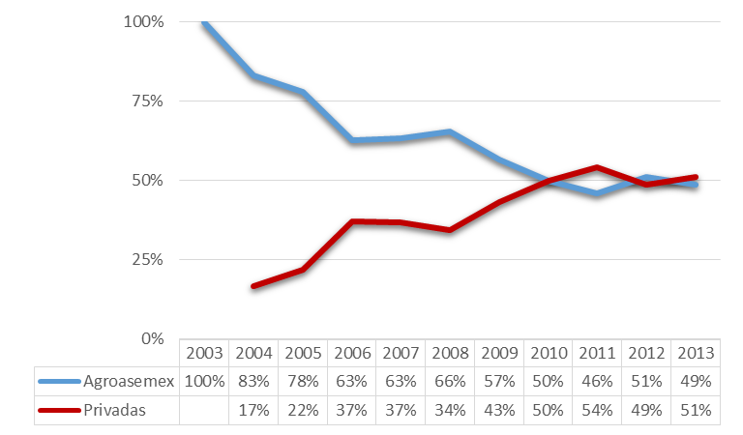
CADENA results
CADENA has facilitated a wide expansion of agricultural insurance covering 12 mo Ha in 2013 representing 65% of total area under production and covers 98% of the country’s municipalities. This represents a safety net for 3.7 mo smallholders, equivalent to 82% of the estimated smallholder population.
Private and public share of the catastrophic insurance market
Coverage of CADENA at the municipality level
Source: FAO, 2014
Source: Data from SAGARPA
Notes:
This is in the context where Mexico’s rural financial system has low coverage of rural areas relative to the LAC average.

Slide 9
Key limitations of model used
Cost-efficiency depends greatly on State Governments building specialized units to determine most appropriate coverage needs, but large federal subsidies are a disincentive to do this. Relying only on coverage advice from insurance companies has not resulted in appropriate coverage for some States, resulting in additional public expenditures
Availability and sustainability of public resources to fund the programme (currently a premium market of over USD 190 mo a year)
Pre-existing capacity of public agencies to collect and analyze relevant climatic and production time series data needs to exist in order to facilitate the development of new insurance products in the short term

Slide 10
Conclusions
Public policy is showing a key role in generating innovation in key aspects to expand agricultural insurance in the developing world:
Reducing basis risk
Designing products that respond to the different risk layers
Fostering risk management tools that deal with non-insurable risks
Apply portfolio approach to insure clients working in agriculture to mitigate basis risk and reduce costs
Creating standards to be able to compare products (levels of basis risk and types of risks covered)
Investments in data and client knowledge.

Slide 11
Thank you for your attention!
www.fao.org/ag/ags
www.ruralfinanceandinvestment.org

