Slide 2
Recovery of Willful Default in Mortgages through NAB

Slide 3
National Accountability Ordinance, 1999
An ordinance to provide setting up of National Accountability Bureau so as to eradicate corruption and corrupt practices and hold accountable all those persons accused of such practices.

Slide 4
Preamble:-
Quote:
Whereas there is an emergent need for the recovery of outstanding amounts from those persons who have committed defaults in the repayment of amounts to Banks, Financial Institutions...
Un- Quote:
We can say it was intention to provide opportunity to defaulter to clean their liabilities.

Slide 5
DEFAULT
Definition as per Black’s Law Dictionary:
“The omission or failure to perform a legal or contractual duty especially the failure to pay a debt when due”.
It becomes Willful Default when a person intentionally deliberately and voluntarily fails to pay a debt when due. The term “willful default ” has not been defined in any other law except the National Accountability Ordinance 1999 which has been given an overriding effect, notwithstanding anything contain in any other law for the time being enforce, according to section 3.

Slide 6
SECTION 5 OF NAO, 1999
Definitions:
a) Accused:
5. (a) "Accused" shall include a person in respect of whom there are reasonable grounds to believe, [that he] is or has been involved in the commission of any offence [triable] under this Ordinance or is subject of an investigation or inquiry by the National Accountability Bureau, or [any other agency authorized by the National Accountability Bureau in this regard under this Ordinance.

Slide 7
b) Associates :
5. (d) "Associates" means:-
i. any person who is or has been managing the affairs [of] or keeping accounts [for] the accused or who enjoys or has enjoyed any benefit from the assets.
ii. any association of persons, body of individuals, partnership [firm] or private limited [company] within the meaning of Companies Ordinance 1984, of which [the accused] is or has been a member, partner or director or which [has] been promoted, floated, established or run by the [accused, whether singly or jointly, with other persons];
iii. A trustee of trust declared by the accused, or of which the accused is also a trustee or a beneficiary; and
iv. “benamidar” means any person who ostensibly holds or is in possession or custody of any property of an accused on his behalf for the benefit and enjoyment of the accused;

Slide 8
c) Person:
5. (o). "PERSON" [unless the context so requires,] includes in the case of a [company or a corporate body], the sponsors, Chairman, Chief Executive, Managing Director, elected Directors, by whatever name called, and guarantors of the company [or body corporate] or any one exercising direction or control of the affairs of such [company or a body corporate] and in the case of any firm, partnership or sole proprietorship, the partners, proprietor or any person having [any] interest in the said firm, partnership or proprietorship concern or direction or control thereof.

Slide 9
Willful Default:
First time made offence and defined under section 5 ( r) of NA Ordinance 1999
5. (r). "Willful Default": a person [or a holder of public office] is said to commit an offence of willful default under this Ordinance if he does not pay [or continues not to pay,] or return or repay the amount [due from him] to any bank, financial institution, cooperative society, Government department, statutory body or an authority established or controlled by a Government on the date that it became due [as per agreement containing the obligation to pay, return or repay or] according to the laws, rules, regulations, instructions, issued or notified by [the State Bank of Pakistan, or the bank,] financial institution, cooperative society, Government Department, statutory body or an authority established or controlled by a Government, as the case may be, and a [thirty days notice has been given to] [such person or holder of public office:]

Slide 10
Provided that it is not willful default under this Ordinance if [such person or holder of public office] was unable to pay return or repay the amount as aforesaid on account of any willful breach of agreement or obligation or failure to perform statutory duty on the part of any bank, financial institution, cooperative society, government department, statutory body or an authority established or controlled by Government:
Provided further that in the case of default concerning a bank or a financial institution a seven days notice has also been given to [such person or holder of public office] by the Governor, State Bank of Pakistan:
Provided further that [the] aforesaid thirty days or seven days notice shall not apply to cases pending trial at the time of promulgation of National Accountability Bureau (Amendment Ordinance, 2001]

Slide 11
Full bench of Lahore High Court Lahore in their judgment reported at PLD 2000 LHR 508 defined willful default as “Non-Payment/return/re-payment of the amount due to any Bank, Financial Institution or statutory institution within thirty days was a “willful” and was continuing offence liable to be proceeded under the National Accountability Ordinance, 1999”
Section 9 (a) (viii) of NA Ordinance, 1999:
Corruption and Corrupt Practices:
9. (a) A holder of a public office, or any other person, is said to commit or to have committed the offence of corruption and corrupt practices:-
viii. if he commits an offence of willful default; or

Slide 12
Section 10 (a) of NA Ordinance, 1999:
Punishment for Corruption and Corrupt Practices:
10. (a). [A holder of public office or any other person] who commits the offence of corruption and corrupt practices shall be punishable with [rigorous] imprisonment for a term which may extend to 14 years, [and with fine] and such of the assets and [pecuniary resources] of such [holder of public office or person, as are] found to be disproportionate to the know sources of his income or which [are] acquired by money obtained through corruption and corrupt practices whether in his name or in the name of any of his dependents, or benamidars shall be forfeited to the appropriate Government, [or the concerned bank or financial institution as the case may be].

Slide 13
Section 31 – D of NA Ordinance, 1999:
31-D: Inquiry, investigation or proceeding in respect of imprudent bank loans, etc.
Notwithstanding anything contained in this Ordinance or any other law for the time being in force, no inquiry, investigation or proceedings in respect of imprudent loans, defaulted loans or rescheduled loans shall be initiated or conducted by the National Accountability Bureau against any person, company or financial institution without reference from Governor, State Bank of Pakistan.
Provided that cases pending before any Accountability Court before coming into force of the National Accountability Bureau (Second Amendment) Ordinance, 2000, shall continue to be prosecuted and conducted without reference from the Governor, State Bank of Pakistan.

Slide 14
Question & Answer Session

Slide 15
Procedure for Referring Cases under Willful Default to NAB
1st Step:
30 days Notice to borrower/director/mortgagor
2nd Step:
Preparation of complaint to State Bank of Pakistan.
3rd Step:
On receipt of compliant after scrutinizing the complaint along with annexures the State Bank of Pakistan issue 7 days Notice
a) Seeks comments from bank on reply by the borrower/defaulter.
b) Governor State Bank of Pakistan passes speaking order.
4th Step:
Files reference with Chairman NAB.

Slide 16
Actions/procedure to be adopted by NAB
1. Inquiry Authorization
2. Investigation Authorization
3. Filing of reference before Accountability Court

Slide 17
Format of Notice u/sec 5 (r ) NA Ordinance, 1999
1. Facilities details and amount due along with due date.
2. Charge and security documents including Mortgage details and personal guarantees.
3. Failure to abide by terms and conditions and outstanding amount.
4. Detail of recovery suit if filed.
5. Willful default para.
6. Demand to liquidate the outstanding a amount within 30 days along with markup charges, cost of funds within thirty days of date of issuance of notice.
7. Without prejudice to suit.

Slide 18
Nature of proceedings under NAO, 1999
Proceedings under FIO, 2001 are of civil in nature and proceedings under NA Ordinance, 1999 are within criminal jurisdiction. It is well settled proposition of law that civil and criminal proceedings can proceeded simultaneously.
Offence of willful default has been first defined and declared as an offence in the legislation history through promulgation of National Accountability Ordinance 1999.
The Honorable Supreme Court in its judgment reported at PLD 2001 SC 607 titled as Khan Asfandyar Wali vs Federation of Pakistan etc has held that the offence of willful default is not ultra vires to the constitution, liberty of trade etc.

Slide 19
Moreover the Honorable Supreme Court of Pakistan recommended three conditions to proceed under section 5 (r) of National Accountability Ordinance 1999; i.e. willful default:
Thirty days Mandatory Notice.
Seven days Notice of State Bank of Pakistan.
Reference of Governor State bank of Pakistan under section 31- D, National Accountability Ordinance, 1999.
Question as to whether Willful Default has been committed or not, squarely falls within the jurisdictional domain of Accountability Court. Said question being question of fact could only be determined on the basis of evidence . Reference PLD 2005 Supreme Court 323 , 2007 SCMR 1569.

Slide 20
Section 25 (a) of NA Ordinance, 1999:
Voluntary Return:-
Notwithstanding anything contained in section 15 or in any other law for the time being in force, where a holder of public office or any other person, prior to the authorization of investigation against him, voluntarily comes forward and offers to return the assets or gains acquired or made by him in the course, or as the consequence, of any offence under this Ordinance, the Chairman NAB may accept such offer and after determination of the amount due from such person and its deposit with the NAB discharge such person from all his liability in respect of the matter or transaction in issue:
Provided that the matter is not sub judice in any court of law.

Slide 21
Section 25 (b) of NA Ordinance, 1999:
Plea Bargaining:-
(b) Where at any time after the authorization of investigation, before or after the commencement of the trail or during the pendency of an appeal, the accused offers to return to the NAB the assets or gains acquired or made by him in the course, or as a consequence, of any offence under this Ordinance, the Chairman NAB, may, in his discretion, after taking into consideration the facts and circumstances of the case, accept the offer on such terms and conditions as he may consider necessary, and if the accused agrees to return to the NAB the amount determined by the Chairman NAB, the Chairman NAB, shall refer the case for approval of the Court, or as the case may be, the Appellate Court and for the release of the record.

Slide 22
Section 25-A of NA Ordinance, 1999:
25-A: Payment of Loans, etc
a). Where an accused person has been arrested or is in the custody of NAB or apprehends such arrest or custody for the investigation of the charge against him of committing an offence of willful default on account of non-payment of dues to a bank or financial institution or cooperative society, he may at any stage before or after such arrest or before, during or after such custody or investigation apply to the Governor, State Bank of Pakistan for reconciliation of his liability through the Conciliation Committee and Governor may, if he deems fit, refer the matter to a Conciliation Committee.
aa). The Governor, State Bank of Pakistan shall constitute one or more Conciliation Committees for the purposes of this Ordinance.

Slide 23
b). The Conciliation Committee shall consist of a nominee of the Governor, State Bank of Pakistan, being a senior officer of the State Bank well qualified in the profession of banking who shall be the Chairman of the Committee, two nominees of the NAB to be nominated by a Chairman NAB, two Chartered Accountants to be nominated by the Governor, State Bank of Pakistan, one Chartered Accountant to be nominated by the Council of the Institute of Chartered Accountants of Pakistan, Karachi, such nomination to be obtained by the Governor, State Bank of Pakistan, a Chartered Accountant to be nominated by the {accused} and a Chartered Accountant to be nominated by the lender bank or financial institution.
Explanation: Where the {lender} is a consortium or group of banks or financial institutions, the lender means the lead bank or financial institution.
bb) The Chairman of the {Conciliation} Committee shall convene the meetings and conduct proceedings of the {Conciliation} Committee in the manner he deems fit.

Slide 24
c). The Conciliation Committee after examination of the record of the lending bank or financial institution and the {accused} and after hearing the parties through their Chartered {Accountants}, shall determine the amount outstanding against the accused calculated in accordance with law, rules, regulations and circulars of the State Bank of Pakistan and further determine the manner and the schedule of repayment having regard to the facts of each case. The accused, if he so desires, shall be heard at commencement and before the conclusion of proceedings:
Provided that the {accused} shall have the right to have access to, and instruct, the Chartered Accountant representing him before the Conciliation Committee even if the {accused} is in custody, during the proceedings of the Conciliation Committee.

Slide 25
d). The Conciliation Committee shall conclude the reference within thirty days and its recommendations shall be recorded by its Chairman and shall contain the views of all members of the [Conciliation] Committee. The recommendations of the Conciliation Committee shall be submitted to the Governor, State Bank of Pakistan.
e). The Governor, State Bank of Pakistan shall consider the recommendations submitted to him under sub-section (d) and may accept the recommendations or may, for reasons to be recorded, pass such other appropriate order thereon as he deems fit. The acceptance of the recommendations of the {Conciliation} Committee or passing any other order as aforesaid shall constitute the decision of the Governor, State Bank of Pakistan.
f). Where the accused undertakes to repay the amount as determined by the Conciliation Committee, the Chairman NAB, with the approval of Court, may release the accused.

Slide 26
g). The decision of the Governor State Bank of Pakistan shall be communicated to the Chairman NAB, which shall be binding on him, except for valid reasons to be recorded in writing subject to approval of the Court, to be accorded within a period of seven days.
h). In the event of failure either of the Conciliation Committee to conclude the reference within thirty days of the commencement of the conciliation proceedings or the failure of the accused to accept and implement the decision of the Governor State Bank of Pakistan regarding the payment and matters relating thereto, such failure to accept or implement the decision shall be referred to the Court subject to the provisions of Section 31-D and the Court may proceed with the case thereafter.
Provided that the period of thirty days may be extended by the Governor, State Bank of Pakistan by such further period or periods as he may find necessary having regard to the facts and circumstances of the case and for reasons to be recorded.

Slide 27
Reconciliation Procedure:
Application to Governor State Bank of Pakistan for reconciliation by accused.
Governor State Bank of Pakistan to Constitute Conciliation Committee .
Members of Committee:
Nominee of the Governor State Bank of Pakistan who shall be the Chairman of the Committee.
Two nominees of NAB to be nominated by Chairman NAB.
Two Chartered Accounts nominated by Governor State Bank of Pakistan.
One Chartered Accountant to be nominated by the Council of Institute of Chartered Accountants of Pakistan, Karachi.
A Chartered Accountant to be nominated by the accused.
A Chartered Accountant to be nominated by the lender bank or financial institution.

Slide 28
Procedure:
Chairman to convene meeting.
Examination of record.
Parties to be heard through their respective Chartered Accountants.
Determine the amount due in accordance with rules, law, circulars of State Bank of Pakistan and further determine the manner and repayment schedule.
If accused desires, shall be heard at commencement and before conclusion of the proceedings.
Proviso:
Accused shall have the access to instruct Chartered Accountant representing him, even if he is in the custody of NAB.

Slide 29
Time:
Thirty days time, which may be extended by the Governor State Bank of Pakistan as he may find necessary on case to case basis.
Conclusion of Committee:
Views of all members along with Chairman’s must be annexed with the report and the same must be sent to Governor State Bank of Pakistan.
Authority of Governor :
Governor State Bank of Pakistan can accept and reject the recommendations of the Committee by giving reasons.

Slide 30
Binding of Governor’s decision:
Decision of the Governor State Bank of Pakistan shall be communicated to Chairman NAB, which shall be binding on him.
If Chairman NAB differs for valid reason than approval must be sought from Accountability Court.
If accused accepts than the Chairman with the approval of court release the accused if in custody.
If reconciliation fails then trial proceeds.

Slide 31
Circulars of State Bank of Pakistan in relation to cases of Willful Default

Slide 33
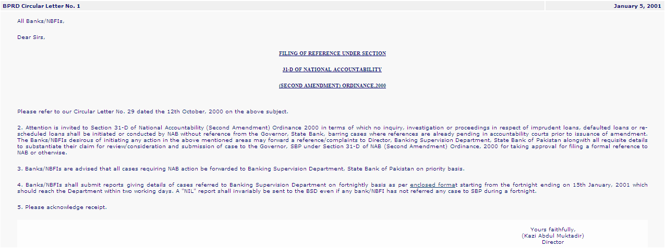

Slide 34
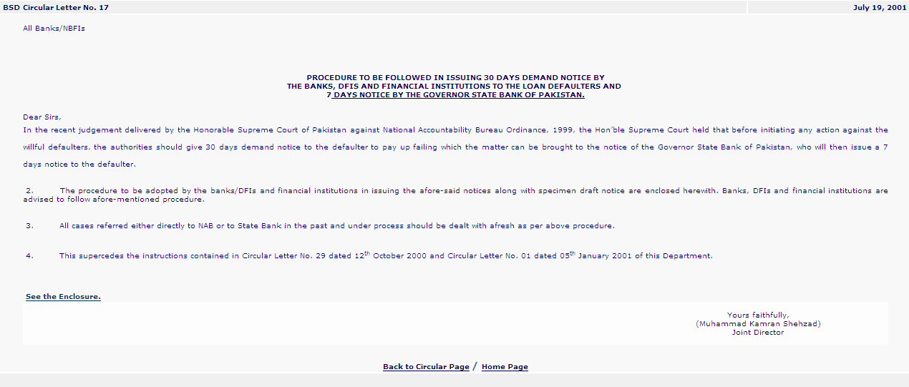

Slide 36
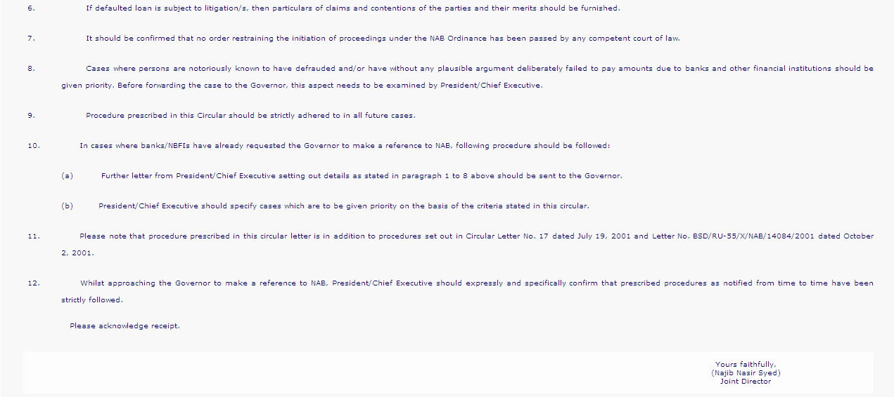

Slide 37
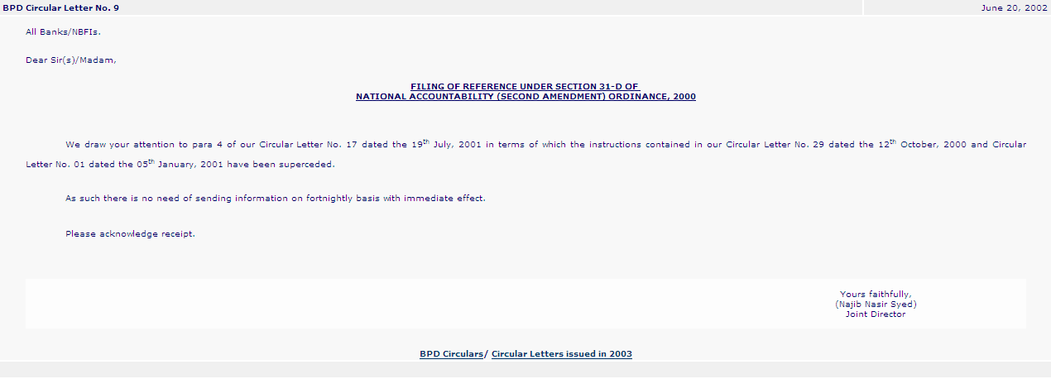

Slide 39
Question & Answer Session

Slide 40
Sahabzada Muzaffar Ali
Deputy Legal Head
Office No 042 35783855
Cell no 0300 8488007

