Slide 1
Getting Credit-EODB Awareness session on Getting Credit Indicator
State Bank of Pakistan

Slide 2
Outline
Pakistan Ranking
Ease of Doing Business Methodology
Reforms under Getting Credit Indicator

Slide 3
Ease of Doing Business Index
World Bank issues ease of Doing Business Index each year (190 countries in 2020).
The index comprises 10 indicators including Getting Credit:
Starting a Business
Getting Credit
Dealing with Construction Permits
Getting Electricity
Registering Property
Protecting Minority Investors
Paying Taxes
Trading across Borders
Enforcing Contracts
Resolving Insolvency
Notes:
Labour market regulations

Slide 4
Pakistan- EODB Ranking 2020
Pakistan ranks 108 on EODB index
Pakistan improved 28 notches on the EODB 2020 compared to EODB 2019
Improvement in Starting a Business, Registering Property, Dealing with Construction Permits, Paying taxes and Getting electricity
Notes:
Higher is better

Slide 5
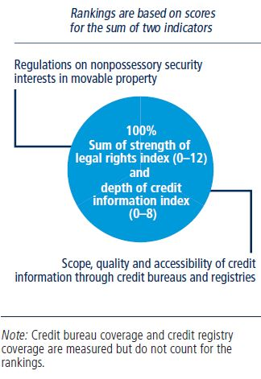
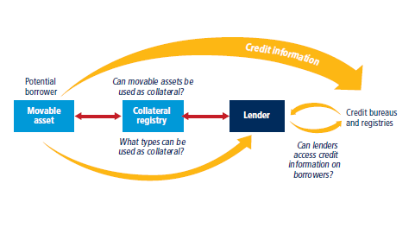
EODB Methodology for Getting Credit
Getting Credit measures the legal rights of borrowers and lenders through two survey questionnaires:
Strength of legal rights(60% weight); and
Depth of Credit information (40% weight)
Notes:
Getting Credit indicator measures effectiveness of the Movable collateral laws and credit information systems
Distance to frontier ranking for all the 10 indicators including aggregate ranking

Slide 6
Getting Credit Indicator- Pakistan
Pakistan ranks 119 in Getting Credit Indicator for 2020
DB2018 and DB2019- Getting Credit
Strength of Legal Rights Questionnaire : 2 “Yes” out of Total 12 questions
Depth of Credit Information: 7 “Yes” out of Total 8 questions
Notes:
Movable collateral laws and credit information systems
Assessment for two cities- Lahore(45) and Karachi(55) ( Population over 100m) 11 economies; population census has changes this weightage may change;
Pakistan 105 in 2018 moved down by 7 notches in 2019. Because other countries have improved their getting credit score

Slide 7
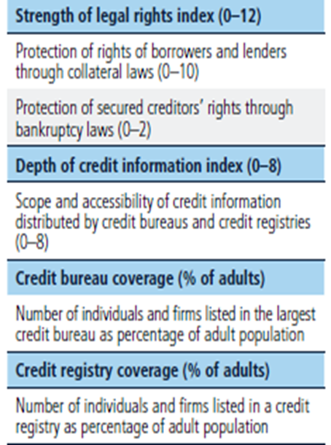
Depth of Credit Information Index
The Index measures rules and practices affecting the coverage, scope and accessibility of credit information available through either a credit bureau (private) or a credit registry (public)
The index ranges from 0 to 8, with higher values indicating the availability of more credit information
A score of 1 is assigned for eight features if it is fulfilled either by a credit bureau or a credit registry or both
Score of 0 is assigned if;
credit bureau or registry is not operational; or
covers less than 5% of the adult population

Slide 8
Strength of Legal Rights Index
The index measures the degree to which collateral and bankruptcy laws protect the rights of borrowers and lenders and thus facilitate lending
The index covers 10 aspects related to legal rights in collat­eral law and 2 aspects in bankruptcy law.
The index ranges from 0 to 12, with higher scores indicating that collateral and bankruptcy laws are better designed to expand access to credit.

Slide 9
Depth of Credit Information Index
EODB Questions | WB Assessment for DB 2020
Q1. Are data on both firms and individuals distributed? | Yes
Q2. Are both positive and negative credit data distributed? | Yes
Q3. Are data from retailers or utility companies - in addition to data from banks and financial institutions - distributed? | No
Q4. Are at least 2 years of historical data distributed? (Credit bureaus and registries that distribute more than 10 years of negative data or erase data on defaults as soon as they are repaid obtain a score of 0 for this component.) | Yes

Slide 10
Depth of Credit Information Index
EODB Questions | WB Assessment for DB 2020
Q5. Are data on loan amounts below 1% of income per capita distributed? | Yes
Q6. By law, do borrowers have the right to access their data in the credit bureau or credit registry? | Yes
Q7. Can banks and financial institutions access borrowers’ credit information online (for example, through an online platform, a system-to-system connection or both)? | Yes
Q8. Are bureau or registry credit scores offered as a value-added service to help banks and financial institutions assess the creditworthiness of borrowers? | Yes

Slide 11
STRENGTH OF LEGAL RIGHTS Index
EODB Questions | WB Assessment for DB 2020
Q1. Does an integrated or unified legal framework for secured transactions that extends to the creation, publicity and enforcement of functional equivalents to security interests in movable assets exist in the economy? | No
Q2. Does the law allow businesses to grant a non-possessory security right in a single category of movable assets, without requiring a specific description of collateral? | Yes
Q3. Does the law allow businesses to grant a non-possessory security right in substantially all of its assets, without requiring a specific description of collateral? | Yes
Q4. May a security right extend to future or after-acquired assets, and does it extend automatically to the products, proceeds or replacements of the original assets? | No

Slide 12
STRENGTH OF LEGAL RIGHTS Index
EODB Questions | WB Assessment for DB 2020
Q5. Is a general description of debts and obligations permitted in collateral agreements; can all types of debts and obligations be secured between parties; and can the collateral agreement include a maximum amount for which the assets are encumbered? | No
Q6. Is a collateral registry in operation for both incorporated and non-incorporated entities that is unified geographically and by asset type, with an electronic database indexed by debtor's name? | No
Q7. Does a notice-based collateral registry exist in which all functional equivalents can be registered? | No
Q8. Does a modern collateral registry exist in which registrations; amendments; cancellations and searches can be performed online by any interested third party? | No

Slide 13
STRENGTH OF LEGAL RIGHTS Index
EODB Questions | WB Assessment for DB 2020
Q9. Are secured creditors paid first (i.e. before tax claims and employee claims) when a debtor defaults outside an insolvency procedure? | No
Q10. Are secured creditors paid first (i.e. before tax claims and employee claims) when a business is liquidated? | No
Q11. Are secured creditors subject to an automatic stay on enforcement when a debtor enters a court-supervised reorganization procedure? Does the law protect secured creditors’ rights by providing clear grounds for relief from the stay and/or sets a time limit for it? | No
Q12. Does the law allow parties to agree on out of court enforcement at the time a security interest is created? Does the law allow the secured creditor to sell the collateral through public auction or private tender, as well as, for the secured creditor to keep the asset in satisfaction of the debt? | No

Slide 14
Major Reforms in the Getting Credit Indicator
K-Electric has started sharing industrial and commercial consumers data with private credit bureaus.
SBP has expanded the capacity of E-CIB to retain two years history of consumer/borrows in e-CIB reports.
SBP had also reduced the reflection period of written off/waived loans and advances for corporate borrowers in eCIB from 15 years to 10 years.
SBP issued Licenses to two private credit bureaus

Slide 15
Major Reforms in the Getting Credit Indicator
Financial Institution (Secured Transactions) Act 2016 has been amended through an ordinance called Financial Institution (Secured Transactions) Amendments Ordinance 2020 in order to modernize and introduce best international practices in the secured transaction regime in Pakistan.
The e-Registry under STA 2016 has been made operational in April 2020 and so 135,925 charges have been registered in STR during last one year.
SECP has issued the rules of the STR.

