Slide 1
SBP-FAO International Conference on
Innovative Agricultural Financing
Islamabad, 28-29 April 2015
Warehouse receipt financing and collateral management
to promote agricultural financing
Lamon Rutten

Slide 2
Overview
The concept
Banking regulators like warehouse receipt finance
Warehouse receipt finance to support value chains – an example

Slide 3
Warehouse receipt finance is a game-changer
France: overcoming mid-19th century social tensions (revolution!) coming from the gap between fast urban growth and lagging agriculture
US agriculture: enabling the development of late 19th/early 20th century agri-processing industry
Globally: leveling the playing field by creating a farmer- and SME-friendly financing instrument
… and a robust instrument, that even works in very difficult environments (warehouse receipt finance has even worked while a civil war was going on).

Slide 4
The concept: turn agri-commodities into gold
Bank
Vault
Implies that the banks knows it’s gold
Deposit gold in bank vault
… and get an ‘easy’ loan
Borrower

Slide 5
So why not extend this mechanism to cereals and other commodities…
Bank
“Vault”
The bank needs to know the commodity’s value
Deposit wheat or rice in bank “vault”…
… and get an ‘easy’ loan
Borrower

Slide 6
What’s a good bank “vault” for agri-commodities?
Bank
“Vault”
Affordable
Safe
Critical issue: the relationship between the bank and its “commodity vault”
How can a bank effectively extend its “vault” to include warehouses suitable for storing agri-commodities?
Borrower

Slide 7
Different possible relationships between the bank and its “commodity vault”…
Post-harvest finance (crops in warehouse)
DD
In bank’s own warehouse
In independent warehouse (“public warehouse”)
In borrower’s warehouse, managed by:
DD
Farmers (“private warehouse”)
Independent collateral manager (“field warehouse” or “collateral management”)
Borrowing corporate
(“private warehouse”)

Slide 8
To make a borrower’s warehouse as safe as its own vault, the bank uses a collateral manager…
A collateral manager accepts liability for the continued presence of (90%) of the stocks. As banks normally only finance up to 80% of the stock value, this makes bank lending safe… as long as the collateral manager has the means to meet his obligations.
Physical infrastructure
A collateral manager “wraps” the warehouse with professional management, improved logistics and grading, and full insurance coverage.
Ware-
house

Slide 9
Collateral management – borrower’s warehouse controlled by a 3rd party. What’s the scope?
Processor, trader
Many grain mills have a warehouse that is physically separate from their milling equipment; or have a warehouse large enough to build a separator wall. So it is possible to physically control stocks as collateral for a bank loan
Warehouse
Collateral Management Agreement:
Full control
Collateral manager
But the problem: This only works is you use a suitable collateral manager:
domain expertise
electronic backing for his activities
access to suitable insurance.
Otherwise, whatever you call it, you have just a monitoring arrangement, without any effective risk transfer to a third party.
Works for the bank !

Slide 10
Collateral management is as much an instrument to finance SMEs as it is to finance farmers
Financier
Payment of invoices
Reporting
Working capital finance
Paper supplier
Collateral manager
Printer
Continuous printing of books during the year
Control
Warehouse
Sale at beginning of school year
Schools

Slide 11
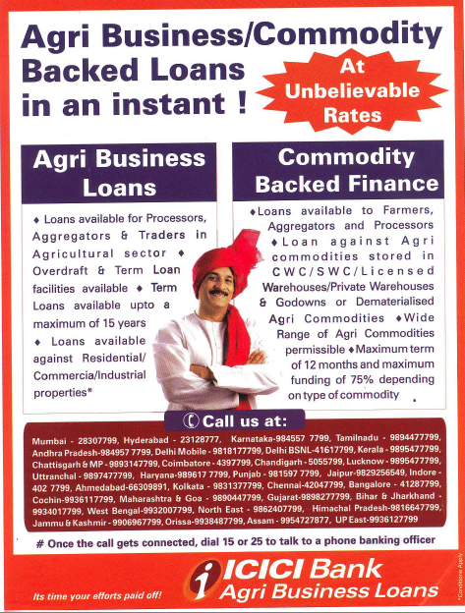
The big success story in India, a CM operating public warehouses
Collateral managers (NBHC, NCMSL) have taken over control of private warehouses, and operates them as public warehouses, open to a large variety of depositors.
NBHC arranges credits for several dozen banks. In many cases, NBHC originates the deal: a farmer or a trader deposits goods in a NBHC warehouse, and if the quality is OK, NBHC staff then arrange a loan from one of the banks from which it has a mandate. The funds arrive in the client’s account the next day…
From 2007 to 2011, NBHC arranged more than 100,000 warehouse receipt financing loans for farmers, starting as small as $ 500.

Slide 12
To properly the manage the risk of warehouse receipt finance:
The public warehouse/collateral manager requires strict procedures
The bank needs to understand the logic of the sector it is financing, and properly use the data provided by the collateral manager
All warehouse receipts should be registered electronically, preferably in one common collateral registry.

Slide 13
A facility for electronic trading of warehouse receipts can become the backbone for a commodity exchange
Physical trading, allowing for example standing orders to sell when a certain minimum price is reached, or physical swaps of a commodity between different warehouses.
Why use physical warehouse receipts? It’s cheaper, easier and safer to use an electronic system. E.g., South Africa’s Electronic Silo Certificates system (ESC).
ESC serves as a basis for exchange delivery systems, for warehouse receipt finance, electronic warehouse receipts trading and information supply (to clients, government agencies).
Most of the grains stored in South Africa pass through the system.
Forward trading, committing the delivery of commodities at a certain time in the future. Leads to better resource allocation and improved logistics (incl. aggregation of shiploads).
Financial transactions, for example a grain mill sells X tons of stock with the agreement to buy it back in 3 months at fixed price Y… The result is competitive capital-market funding of inventory, and a new investment option for (institutional) investors.

Slide 14
Proper warehouse receipt finance, including through the use of collateral managers, is a relatively safe form of finance, and this is recognized under Basel 2, and by many Central Banks
1. Lower provisioning
Total loan size: 100, plus profit of 5
Capital requirement: 20%
CE: 20
5
Return on capital: 25%
2. Discount facility

Slide 15
2. Discount facility
Submission of the loan of X $, with documentary proof that it is a proper warehouse receipt loan, for discounting
Grain mill
Loan of X $
Bank
Central Bank
Collateral manager
Loan of X $, at the official discount rate
Documentation
Operation: clause in Central Bank’s regulations:
Eligible Transactions
can be discounted at the lowest preferential rate for the period with the Central Bank
by Eligible Banks

Slide 16
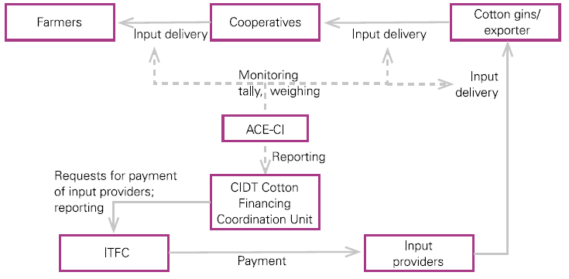
Islamic Trade Finance Deal of the Year, 2009
– 35 million Euro cotton financing in Côte d’Ivoire
Warehouse receipts can play an important supporting role in larger value chain financings. For example, a transaction to revive the cotton industry in Côte d’Ivoire, destroyed by civil war. 80,000+ cotton farmers benefited of a structured deal put in place by a collateral manager for ITFC (part of IDB). The deal was structured from input distribution to export of the final product.

Slide 17
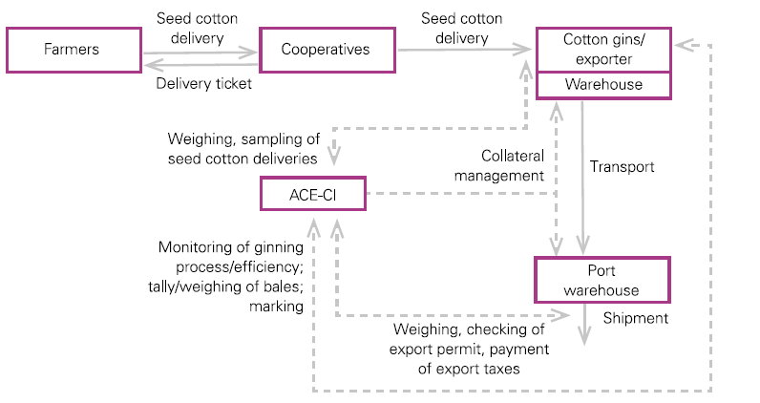
The deal was highly successful, and was repeated the following year.
Warehouse receipt finance/value chain finance is highly compatible with various forms of Islamic finance. For more reading on this, google UNCTAD, Structured finance and Islamic finance: where the twain can meet.

Slide 18
Conclusion
Warehouse receipt finance…. A versatile instrument
Permitting farmers to avoid distress sales
Permitting all actors in the value chain to remove the burden of financing inventory from their balance sheet
Permitting banks to lend more at lower risk
With as larger effects:
More profitable farming
Unlocking the collateral value of capital assets for investments, rather than having it blocked as collateral for working capital loans
More efficient markets, both for commodities and finance
Lower costs in the value chain, to the benefit of both producer and consumer.

Slide 19
Thank you !
You prate of the wealth of nations, as if it were bought or sold;
The wealth of nations is men, not silk and cotton and gold.
Richard Hovey
“If your plan is for one year plant rice. If your plan is for ten years plant trees. If your plan is for one hundred years educate children.”
Confucius

