Slide 1
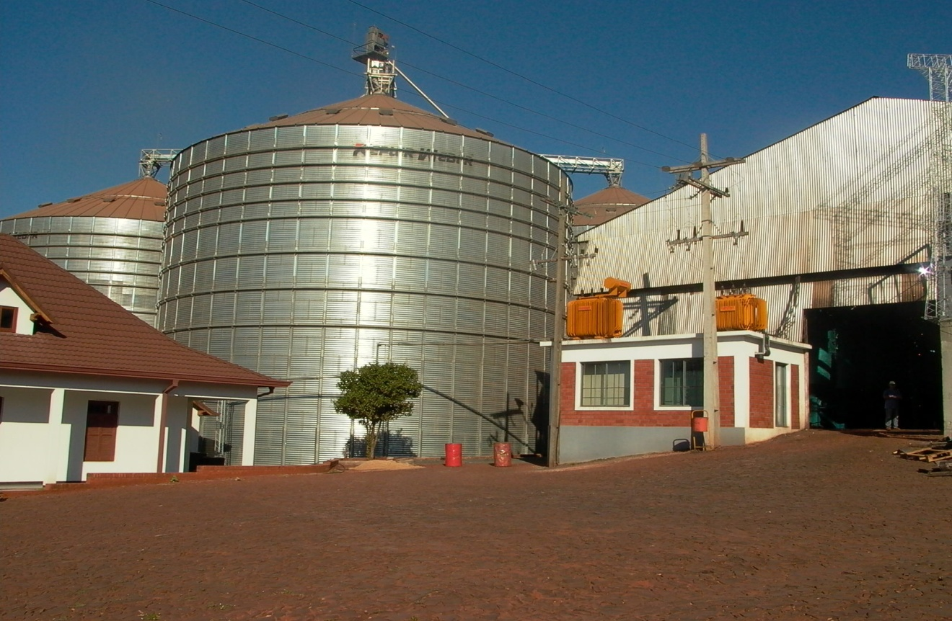
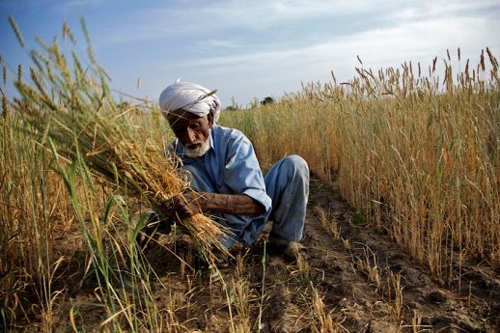
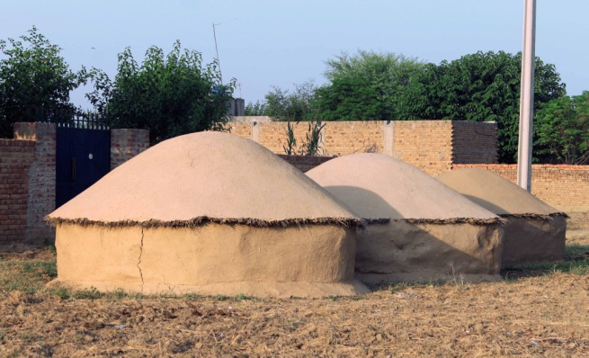
Warehouse Receipt Financing Moving Towards Implementation in Pakistan
Innovative Agriculture Financing
SBP- FAO Conference, Islamabad April 2015

Slide 2
The Context
Large unmet credit requirement in the farming sector
Estimated Total Credit Requirement: USD 7.50 B
Cumulative Disbursements FY 15 USD 3.26 B
Commercial Bank’s share: USD 2.43 B
This is only 5% of total bank lending
There are estimated to be 7M farmers as per an old census
Only 2.15 m farmers borrow from institutions. Commercial banks customer share is only 5%
So what can be done ….
Need to increase cheaper and inclusive financing for farmers
Need to make lending to farmers less expansive and less risky for banks by introducing WHR and value chain linkages
    Secured collateral = cheaper financing;
    WHRs will reduce barriers to entry;
    Banks will encourage clients to use WHRs – enhanced liquidity in system.
Need to increase grain storage capacity of good standard
Need to introduce better warehouse management skills

Slide 3
Benefits of Warehouse Financing
Producer/farmer
Choose when to sell & manage price volatility to get the best price for the produce
Access finance to meet cash needs w/o fixed collateral
Processor /Traders/ Exporter
Manage timing of sales & purchases to access best market price
Store seasonal produce to meet annual production
Banks
Public Warehouses
Markets
Guarantees the quality and quantity of the produce
Finance production in a timely manner
Improve market information/ competition
Reduce post-harvest losses & improve storage capacity/ quality
Attracts more business
more income from handling and storage fees
Opportunity to finance their own operation by issuing WHR to themselves
Expand loan portfolio to agricultural clients
Higher protection for the collateral
Obtain liquid collateral under secure conditions
More income from credit portfolios in rural markets
Profit from warehouse performance guarantees
Higher liquidity of the collateral
Improved assess to quality raw material
Opportunity to plan year supplies
Reduced storage costs
Can finance their stocks
Consistent supplies
Improved logistics

Slide 4
Spectrum of Warehouse Financing Systems
Least Developed
Fully Developed
Stock Monitoring Agreement
Collateral Management Agreement
Warehouse Receipt System
SMA Key Elements:
  Agreement to finance inventory on Borrower premises
  Lender engages SM company to monitor inventory levels
SMA Challenges:
  Collateral Control/ Quality
  Open to Fraud
  Excess Collateral
CMA Key Elements:
Tri-partite agreement with bank, borrower & CM company
Collateral manager maintains full warehouse & commodity quality control
CMA Challenges:
  Need for good collateral manager and warehouses
  Costs
WRS Key Elements:
Legal & regulatory policies govern warehouse & WH finance loans
Licensed & publicly-accessible warehouses
WRS Challenges:
  Legal/Regulatory Environment Set-up
  Warehouse Oversight
  Discoverable Prices

Slide 5
Moving Towards Warehouse Receipt System in Pakistan: Issues to be addressed
A. Regulatory environment
B. Unsuitable warehouse storage facilities
C. Unsuitable warehouse management infrastructure
D. Lack Risk assessment skills
E. Lack of suitable product and process design
F. Training requirement of staff in this product and business

Slide 6
Some of the questions raised by bankers in Pakistan in IFC- SBP WHR workshops
What should be the priority choice of crop/ commodity for WHR?
How would the warehouse management co be regulated and rated ?
What would be the implications on the existing lending against pledge to about 10,000 premium customers of banks?
What would be the additional cost implications of a WHR system? Transportation, insurance etc
Who gets the first charge/ claim of right in case of default?
What is the status of the WHR in absence of a specific legislation?
How to solicit interest of investors in building of storage facilities?
Do we really need a specific legislation or the system can move forward under the existing contractual law framework? WHR will be an endorsable instrument rather than a financial instrument. What does this imply?

Slide 7
Moving Towards Warehouse Receipt System in Pakistan
Short term steps
Evaluation and prioritization of commodities to be included; export oriented, price incentives for storage, volumes
Pilot projects based on three party contract agreements with selected warehouses and borrowers
Assessment of the warehousing industry and categorization based on financial and technical conditions
Development of the financial product, internal bank rules and manuals and training of the loan officers
Creating a cluster of reputable collateral management companies and warehouses and expanding the expertize in SMA and CMA into WHR

Slide 8
Moving Towards Warehouse Receipt System in Pakistan
Medium and Long term steps
Development of all supporting legislation
Development of the warehouse receipt as a standard security paper
Establishment of uniformed licensing criteria
Standardized inspection procedures
Introduction of performance guarantees mechanism
Development of secondary market for WHR

Slide 9

Warehouse Finance – IFC Model Illustration
IFC Advisory to
Warehouse Operators:
Standard Operating Procedures
Staff Training
Labor Standards
IFC Advisory to
Agribusiness or Farmers:
Productivity
Standards
Business practices
Commodity stored in warehouse
3rd Party Warehouse
IFC Advisory to
Government:
WHR Law/Regulations
Collateral Rights/Enforcement
Indemnity Fund
Agri Producers/
Distributors
Warehouse receipts issued by warehouse
WHR Loan
BANK
IFC Advisory to
Banks:
Credit Risk Assessment
Commodity Price Risk
Policies / Procedures
Expand Client Base to Farmers/Agri-SMEs
GWFP RSF/Guarantee

Slide 10
Thank you
Questions, Discussion

Slide 11
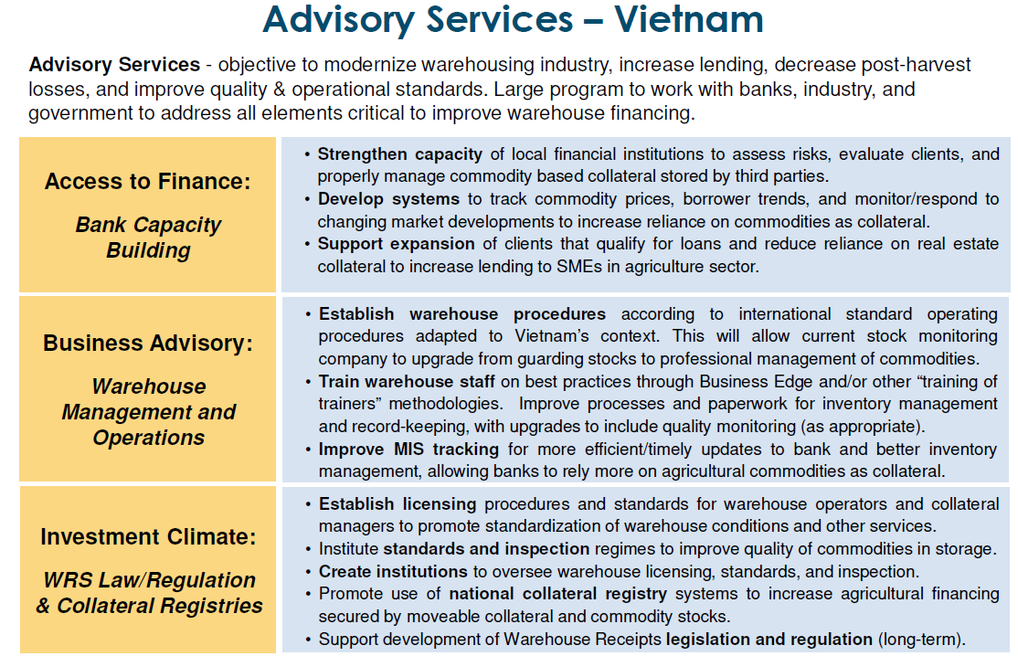

Slide 12
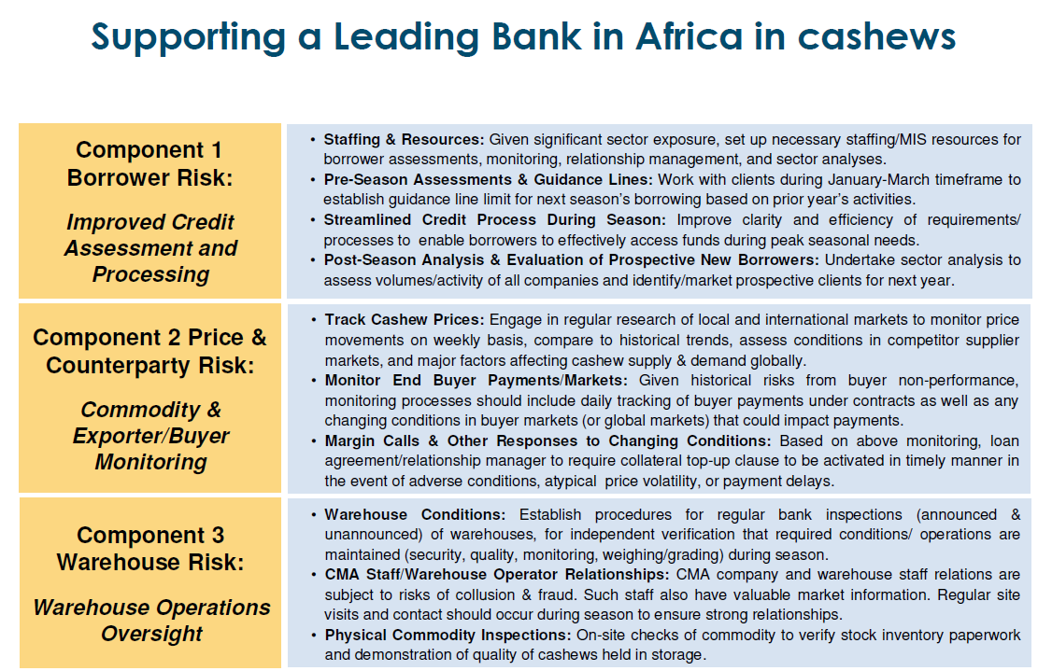

Slide 13
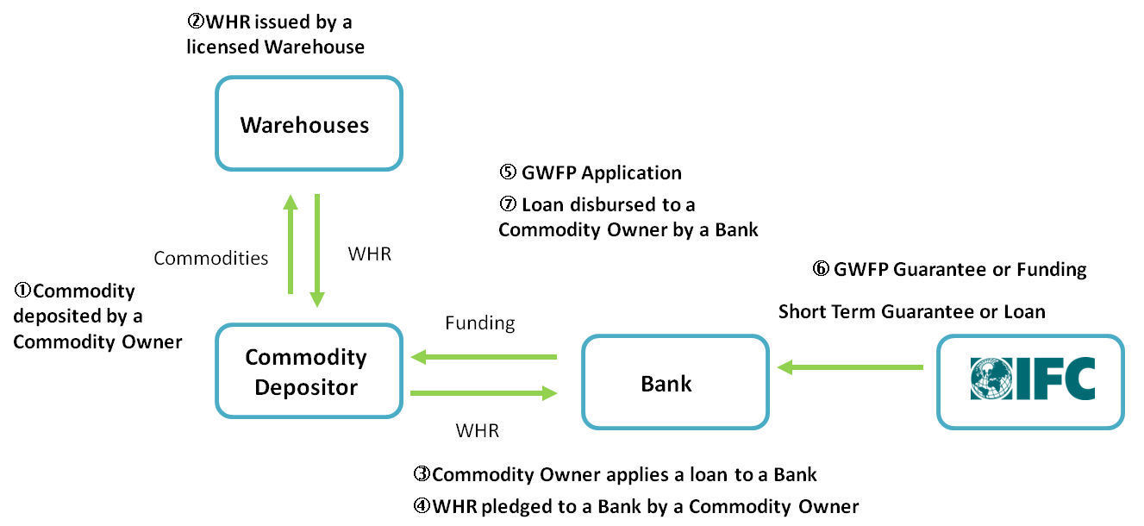
Global Warehouse Finance Program
The IFC’s Global Warehouse Finance Program (“GWFP”) was established in September 2010 to support banks when lending to the agricultural enterprises against warehoused commodities. IFC supports the agriculture sector by facilitating warehouse financing through banks, by providing liquidity for on-lending or risk mitigation solutions.
Credit Line
IFC will offer a short term loan to a bank which will on-lend the funding to commodity depositors against warehouse receipts (WHR) or equivalent as collateral such as Collateral Management Agreement (CMA).
Funded/Unfunded Risk Sharing
IFC will guarantee up to 50% of short term loans extended to commodity depositors against WHR or equivalent as collateral.

