Slide 1
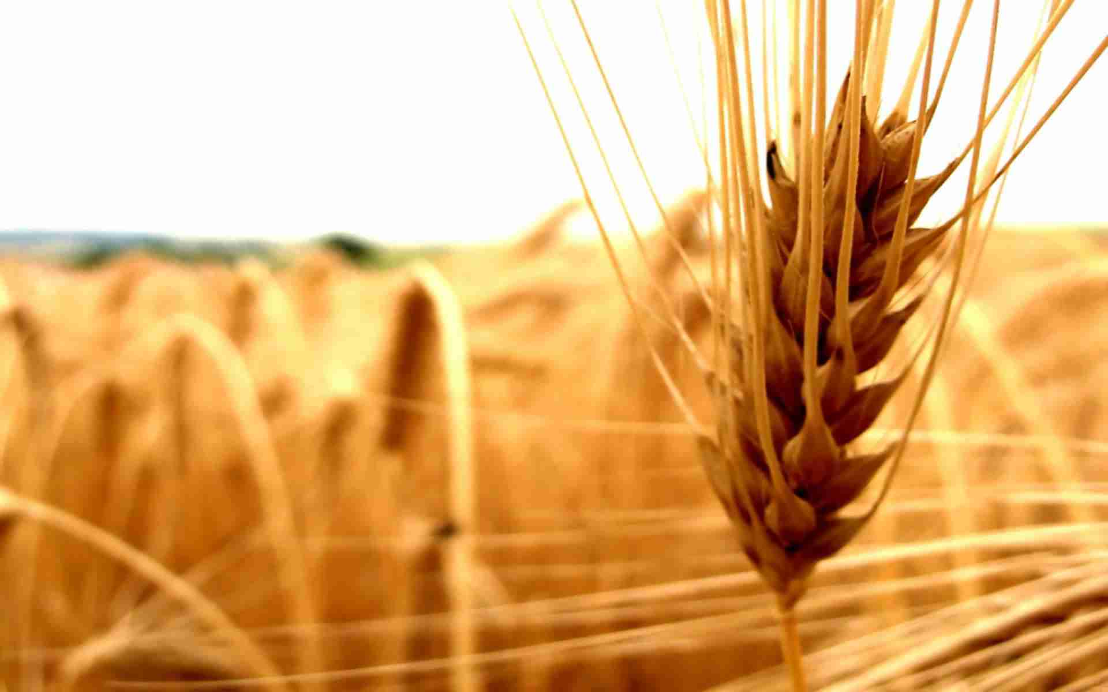
Promoting Agriculture Financing through Islamic Banks-
Challenges & Opportunities
at
International Conference on Innovative Agricultural Financing
April 28-29, 2015 at Hotel Serena Islamabad
Organized By:
Muhammad Zubair Mughal
Chief Executive Officer
Allhuda centre of Islamic banking and economics

Slide 2
Contents
Why Islamic Agricultural Finance ?
Source of Islamic Agricultural Finance Product.
Compatibility of Islamic Financial Products with Conventional Rural Credit lending Models.
Opportunities, Challenges and Innovation.

Slide 3
Why Islamic Agricultural Finance?
Prohibition of Interest.
Approximately 44% conventional microfinance clients worldwide reside in Muslim countries
Tool of financial inclusion.
Asset Based Financing & Risk Sharing – Impact.
72% of people living in Muslim countries do not use formal financial services
Takaful ( Islamic Insurance)

Slide 4
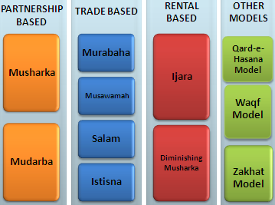
Source of Islamic Agri. Finance Products
Sources of Islamic Finance
Product Mechanism
Quran
Sunnah
Ijma’a (jurist consensus)
Ijtihad & Qiyas (analogy)

Slide 5
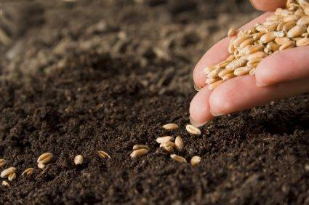
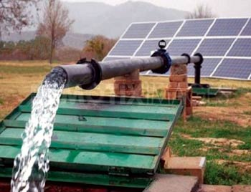
Islamic Agricultural Finance Products
Murabaha – Cost Plus Sale
Murabaha means a sale on mutually agreed profit, also known as cost plus sales, it is one of the most widely used instruments for short-term agricultural financing where the Bank/MFI undertakes to supply specific goods or commodities at mutually agreed profit to the client.
Utilization :
Murabahah can be utilize for Purchase of seed, fertilizer, harvesting and planting equipments, agri. Inputs, tractor, pesticides, farming goods, Solar Tube-wells etc.
Currently Practiced:
MBL and some other Banks, NRSP – KPK, Al Amal Bank, Islamic Bank Bangladesh,
FINCA-AF, Islamic Relief, BMT’s in Indonesia etc.

Slide 6
Islamic Agricultural Finance Products
Salam – Forward Sale
Salam means a contract in which advance payment is made for goods to be delivered later on. The seller undertakes to supply some specific crop/goods to the buyer at a future date in exchange of an advance price fully paid at the time of contract
Utilization
Salam is ideal product for Agricultural Financing, through which a farmer can fulfill all the financial needs of the crop circle e.g. liquidity, seed, pesticide, fertilizer, harvesting, irrigation, market linkages etc.
Currently Practiced:
Wasil Foundation, Albarakah MPCS, MBL etc.

Slide 7
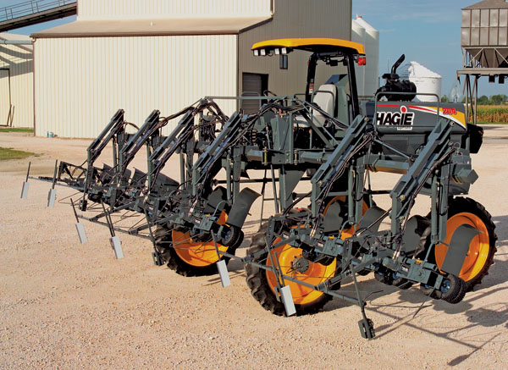
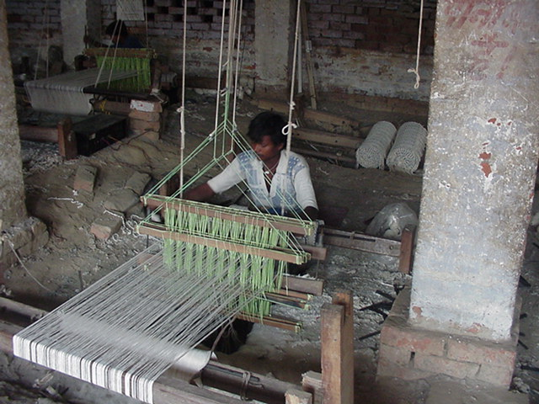
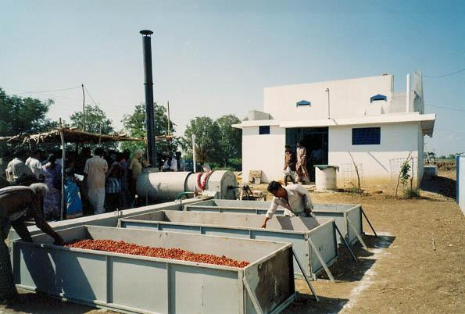
Islamic Agricultural Finance Products
Istisna - Manufacturing contract
A pre-delivery financing instrument used to finance projects where commodity is transacted before it comes into existence. It is an order to manufacture and payment of price, unlike Salam, it’s flexible, where price may be paid in advance, or in installments or on delivery of good.
Utilization:
Istisna May Utilize for small manufacturing Business, dairy or Agri. production, Construction of godowns and cold storage, Rural entrepreneur Development etc.
Currently Practiced:
AlBaraka MPCS, Ghana Islamic Microfinance bank,
Alamal Bank, Bank of Khartoum etc.

Slide 8
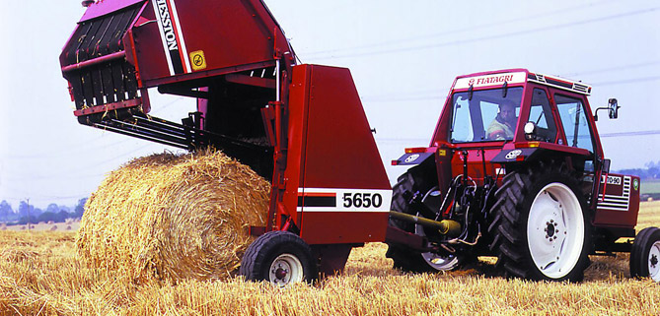
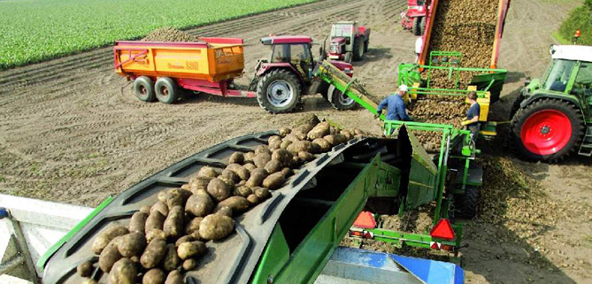
Islamic Agricultural Finance Products
Ijara – Islamic Lease
Ijarah Means Operating lease. It is an arrangement in which the Islamic Bank lease Agri. equipments, Tractor & light vehicles, Agri. Instruments, buildings or other facilities to a client, against an agreed rental.
Utilization :
Leasing of Tractors, Agri. Equipment, Threshers, Tub wells, small production unit lease, Sugarcane planter, Rice planter, harvesting vehicles etc.
Currently Practiced:
Al-Amal Microfinance Bank, NRDP, Wasil Foundation.
Amanah Islamic Bank – Philippines.

Slide 9
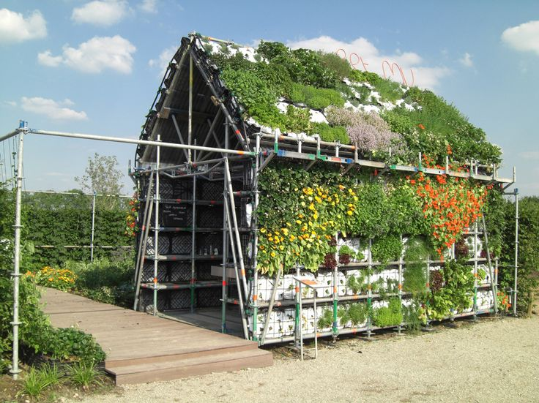
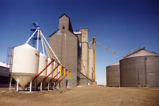
Islamic Agricultural Finance Products
Diminishing Musharkah
Diminishing Musharkah is a form of Musharakah where the Bank/MFI and the client participate in a joint commercial enterprise or property. This attains the form of undivided ownership of both, Over certain period the equity of financier is purchased by the client
Utilization:
It can be utilize for Rural housing, forest development, agri. Inputs, farming, sprinkler/drip/solar pumps, tube wells, Refrigeration vans etc.
Currently Practiced:
Islamic Bank Bangladesh, some Islamic banks etc.

Slide 10
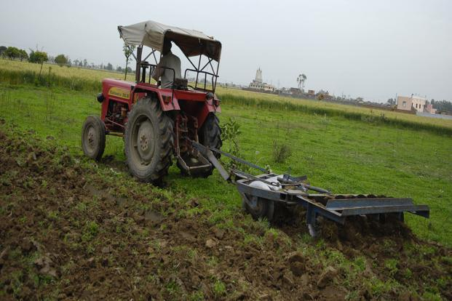
Islamic Agricultural Finance Products
Musharakah & Mudarabah- Partnership
Musharakah & Mudaraba means a relationship established under a contract by the mutual consent of the parties for sharing of profits and losses in the joint business.
Utilization :
Musharkah and Mudarabah can be used for Microenterprise & SME’S setup’s, Agricultural Joint venture projects, Dairy and livestock development etc.
Currently Practiced:
BOK, Amanah Islamic bank, AlBarakah MPCS etc

Slide 11
Compatibility IF Products with Rural Credit lending Models
Grameen Model: Amna Itikhar – Malaysia, Islami Bank Bangladesh Limited etc.
Village Bank Model: Sanadiq program -Jabal al-Hoss, Syria, FINCA - Afghanistan etc.
Credit Union Model: Muslim Credit Union (Tobago), The Amwal Credit Union etc.
Cooperative Model: AlBaraka MPCS – Mauritius, Al- Khair Coop. – India, Muslim Community Coop.– Australia, Karakorum Cooperative Bank – Pakistan.
Self-Help Group: Aameen Society - India
For Profit Banks/MFIs Ghana Islamic Microfinance Banks – Ghana, HSBC Amanah – U.K, MBL-Pak.

Slide 12
Challenges
Non - Availability of Donor/Shariah Compliant Sources of Funds
Need to develop a uniform regulatory and legal framework for the Islamic Agricultural Finance.
Accounting & I.T systems., Rating Agencies.
Lack of Quality HR in Islamic Agri./Rural Finace Sector.
Standardization of Products.
Reluctance in Research & Implementation of new Products, as only (Murabahah) is serving almost 80% of Islamic Agri./Microfinance Industry.
Introduce new product line on the basis of Musaqa, Muzara’a & Mugharasa
Development of Shairah Expertise towards the Growth of Islamic Agricultural Finance.

Slide 13
Opportunities
IDB - Microfinance Development Program (MDP )
Islamic Microfinance Network (IMFN) for an effective interface and Coordination among IMFI’s
Supportive role of Govt. of Pakistan & SBP.
Expansion of Market where the Conventional Agri. Finance Products face limitations especially in Muslim Majority Countries
AlHuda Centre of Excellence in Islamic Microfinance is offering Services for the development of Islamic Agri. Finance Products
Islamic Banking and Finance is emerging in South Asia, Central Asia & MENA region which will strengthened the Islamic Agri. Finance products effectively.

Slide 14
Innovation
Sukuk – Ideal for Corporate Farming.
Micro Takaful Products for Crop insurance, Livestock, Agri. Inputs, Tractors etc are available in Pakistani Market.
Branch less Banking in Rural Area’s
Livestock Models and agricultural development operations through Islamic Microfinance Institutions.
Micro energy & Micro Saving products
NRSP & BOK Venture for Shariah Compliant Finance in Rurul area’s of KPK – Case Study.
Agri. Based Halal Industry can developed through Islamic Finance

Slide 15
JazzakAllah Thank you for listening with patience
Muhammad Zubair Mughal
Chief Executive Officer
AlHuda Centre of Islamic Banking and Economics
Zubair.mughal@alhudacibe.com
www.alhudacibe.com

