Slide 1
Increasing Role of Private Banks in Agri Finance:
A Policy Case from Turkey
April 28th, Islamabad
Omer F. Demirhan
Senior Agricultural Banking Expert

Slide 2
Agri Finance in Turkey Boosted with the Gov. Policy & Competition & TA to Private Banks
Agri Loans:
$ 19.8 Bln
2004
Only government bank has substantial agri finance facilities
Share of Private Banks: %5
2005
A private bank started Agri Banking
Gov. bank started Subsidized Agri Loans Scheme
2010
# of Agri Banks: 4
Share of Private Banks: 27%
TA services for Agri Finance by FSFM Started
2014
# of Agri Banks: 11
Share of Private Banks: 36%
Agri Loans:
$ 14.8 Bln
Agri Loans:
$ 2.3 Bln

Slide 3
Government’s Agri Loans Scheme
Subsidized Interest Rate
25% – 100 % subsidization for current interest rate (effective rate 0 – 9,75%)
Longer Maturities
Working Capital Loans: up to 2 years
Restructuring Mechanism
In case of delinquency, postpone the payment to next harvest
Upper limit for working capital loans: $ 200K
Upper limit for investment loans: $ 5 mln
Investment Loans: up to 7 years
2 years grace period for horticulture, dairy, greenhouse
In beginning, it was only for drought and floods, then it became very wide
100% LTV in some years
Some Distortion Effects of Government Scheme:
Government bank had difficulty to meet the demand, to maintain the quality of service
Over-lending for some products created a boomerang effect
Weak control & monitoring increased number of “farm for sales”
Government cut the subsidy sometimes that created uncertainty and disruption
“Crowd-out effect” for private banks was strong!

Slide 4
A Broad Range of TA Services Has Given to Private Banks by FSFM
Lending Tools Products | Client Assessment Programme (ALES), latterly TARDES under KKB
Capacity Building | Agri segmentation
 | Agri organization
 | Agri Policies & Legislation
New Products Developed for PBs | Medium-Long Term Working Capital and Investment Loans
 | Animal Husbandry Loans (Livestock, Sheep-Goat, Poultry, Beekeeping, etc.)
 | Agri Card
 | Schemes and special loan types for VCF
Trainings (incl. ToT) | Agricultural Banking Marketing & Sales
 | Agricultural Lending (Basic, Project Finance)
 | On-the-job Trainings
 | Branch Coachings
 | Study Tours (domestic/abroad)
Other Services | Project Loans Evaluation
 | Market Research
 | Sectoral Reports, Product Reports, Ad-hoc Reports i.e. Effects of Climatic Drought
 | 3 large-scale international agri-finance conferences
 | Agri Fairs

Slide 5
ALES fulfilled the necessity for a fast and secure agri lending for Turkish private banks
Loan Application
Farmer’s Info
Loan Types: Working Capital Loans , Investment Loans, Agri Cards
Loan Terms: Limit, Maturity, Repayment Type, Interest
Financials
Non-Agricultural Revenues & Expenses
Bank and Non-bank Debts
Question naires
Crop Production, Livestock, Dairy, Poultry, Sheep, Beekeeping
Agri
Financials
Product Name, Quantity, Yield, Price, Revenue, Cost, Collection Time
Result
Quality Result
Recommended Limits, Overall Limit, Other Financials
Maturity

Slide 6
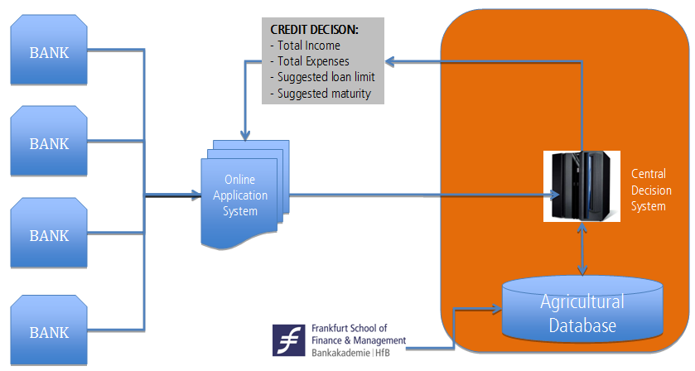
A Centralized ALES Rebuilt in Credit Bureau of Turkey

Slide 7
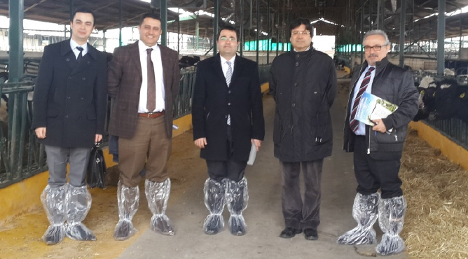
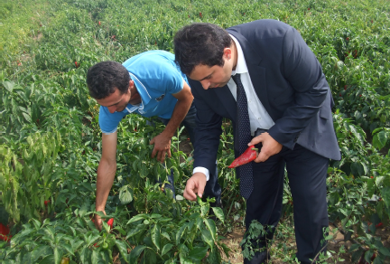
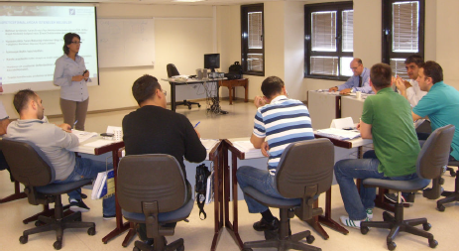
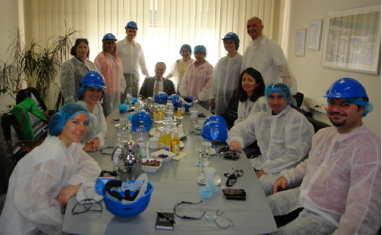
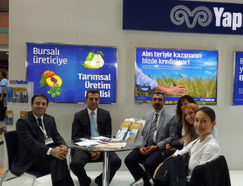
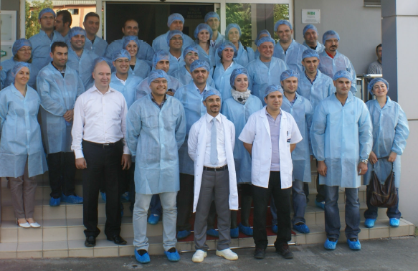
Private Banks Realized the Positive Effect of Being “In the Field”

Slide 8
Agri finance capacity of the Turkish private banks reached to a remarkable level in 5 years
Facts & Figures | 2010 | 2014 | Δ
# of Private Banks with Agri Finance Facilities | 4 | 12 | 200%
Total Agri Loans Volume | TRY 22.8 bln | TRY 45.9 bln | 101%
Agri Loans Interest Rate (p.a.) * | 26% | 19% | – 27%
Agri Loans NPL Rate (sector) | 4.2% | 2.9% | – 32%
Share of private banks in total agri loans | 27% | 36% | 33%
* Average of the initial 4 banks indicated in first row

Slide 9
Thank you!
Omer F. Demirhan
Senior Agricultural Banking Expert
Frankfurt School of Finance and Management
Ankara/Turkey
+90-530-0675051
o.demirhan@int.fs.de

