Slide 1
Why should banks adopt innovative VC Financing models?
Calvin Miller
FAO, Rome, Italy
Promoting Agriculture Value Chain Financing Seminar
March 20, 2015

Slide 2
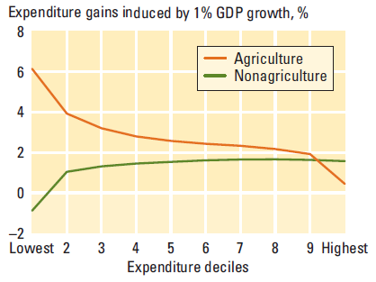
Growing public interest on agribusiness
Source: Ligon and Sadoulet, 2007
Growth in the agricultural sector has a stronger positive impact on the poorest compared to growth in the non-agricultural sector

Slide 3
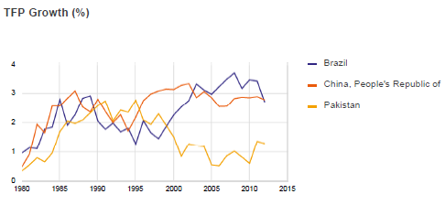
Productivity growth
Agricultural total factor productivity (TFP) = total output/total production inputs (land, labor, capital and agricultural inputs)
3

Slide 4
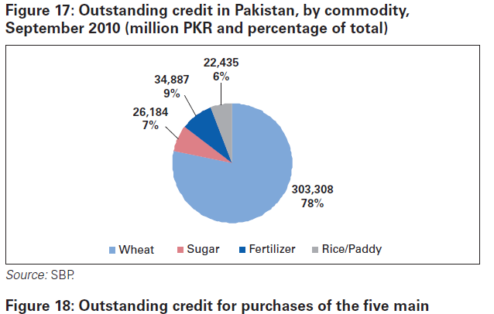
Where does the credit go?
Outstanding credit in Pakistan, by commodity,
September 2010 (million PKR and percentage of total)
Is the investment targeted most effectively?

Slide 5
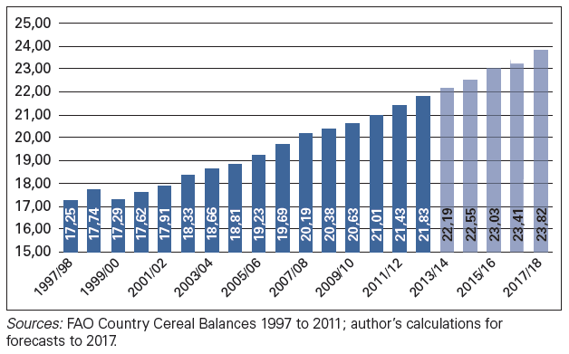
The demand for wheat in Pakistan
Wheat for food consumption in Pakistan, 1997/98 to 2011/12 and anticipated until 2017/2018 (thousand tonnes)

Slide 6
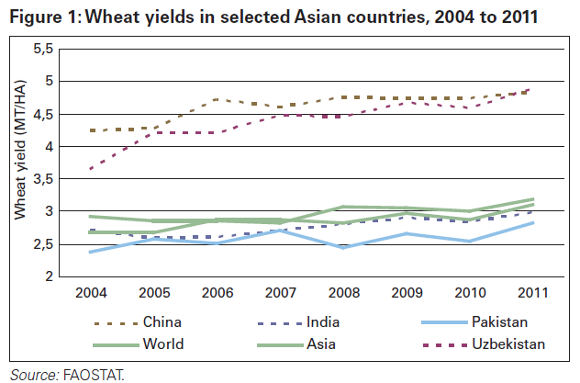
Low yields – is low investment a culprit?
Wheat yields in selected Asian countries, 2004 to 2011
Average wheat yields in Pakistan are below its neighbors despite a high percentage under irrigation
Notes:
Why – productivity is not keeping up due to low inadequate irrigation infrastructure andinsufficient farm inputs.

Slide 7
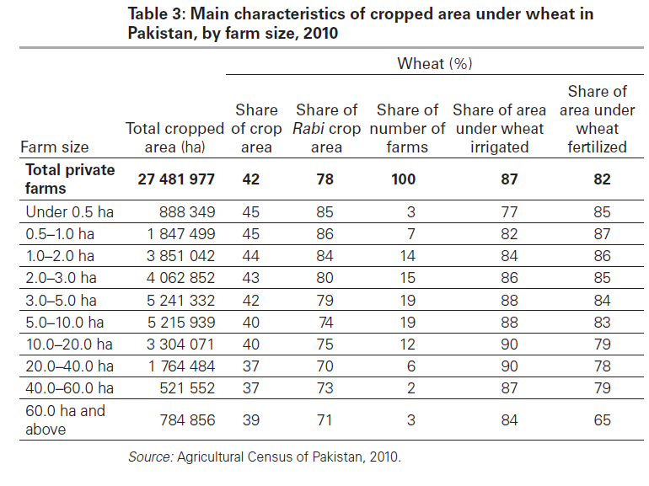
Who are the clients?
Main characteristics of cropped area under wheat in Pakistan, by farm size, 2010

Slide 8
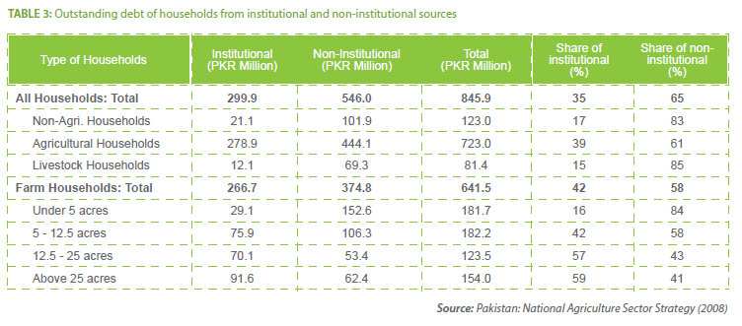
What is the financial situation?
Outstanding debt of households from institutional and non-institutional sources
8

Slide 9
A strong business case for agricultural financing; a need for a new approach to do it
Commercial banks of Pakistan make up over 80 % of the financial sector. Yet, their banking model hardly reaches the 61% of farmers with less than 5 acres of land and even the 33% with 5-25 acres even though agricultural finance has large growth potential and can be very profitable
There is no business case to reach them with the current business models – the business models must adapt.
NIBAF/PMN Arti study
9

Slide 10
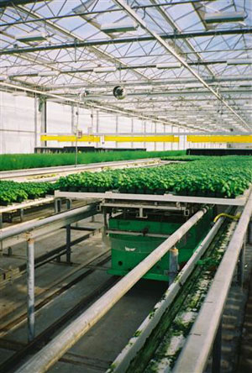
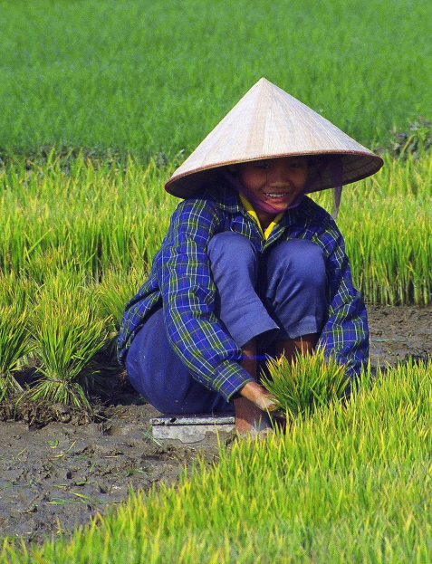
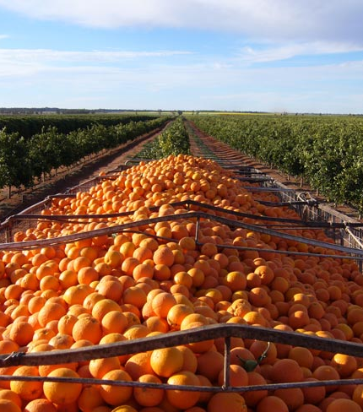
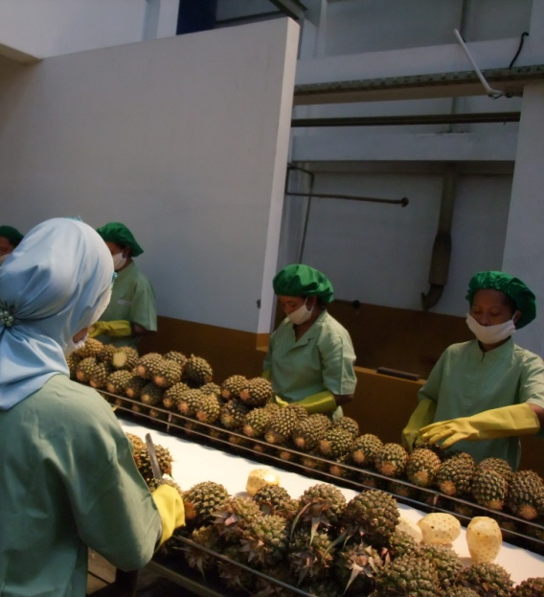
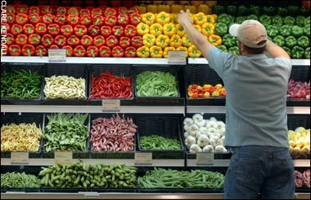
Agriculture and agribusinesses have characteristics that make financing and investment unique

Slide 11
What is needed in investment?
Successful private investment entities tailor their approach to the socio-economic context
Most use some combination of the financial tools and risk mitigators
The process of identifying the most pressing constraints for agribusiness investors and producer groups is crucial
The approach, tools and relationships are also crucial for enabling inclusive financial services and agribusiness growth

Slide 12
A need for structured financial mechanisms and services to fit the value chain
Design based on in-depth understanding all segments of the value chain, to tailor financial services to agribusiness needs
Parallel interventions of financing and access to technical assistance to processors as well as producer organizations.
Staff specialized in agricultural finance lead the design and delivery of financial services
Mechanisms to protect portfolios rather as well as the individuals to increase access to finance
Examples: Credit guarantees, agricultural investment funds, hedging instruments, agricultural insurance and credit and savings products

Slide 13
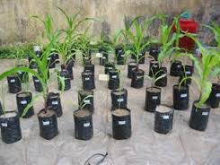
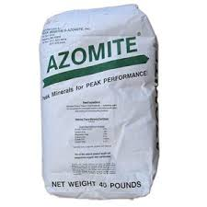
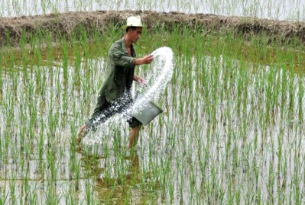
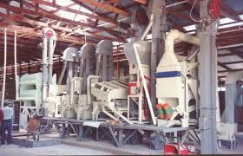
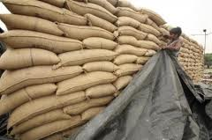
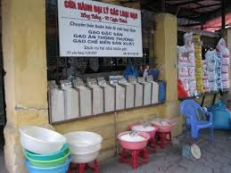
Where do we invest in the VC?
Consumer
Input
Supply
Production
Processing
Wholesale
Retail

Slide 14
New initiatives – what will they bring
New credit guarantee scheme in Pakistan for small and marginal farmers, one that encourages banks to lend to those who previously have not had access to banking facilities.
Guarantees up to 50 percent in credit will be given by the financial institution to farmers who own up to five and ten acres respectively of irrigated and unirrigated land.
Crop-loan insurance scheme to cover the risk posed by natural calamities, climate change, and plant disease.

Slide 15
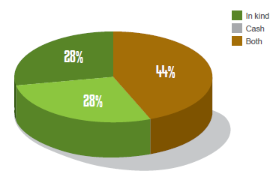
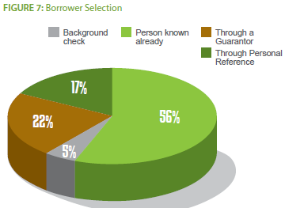
Learning from the Artis
Mode of Lending
Borrower Selection
15

Slide 16
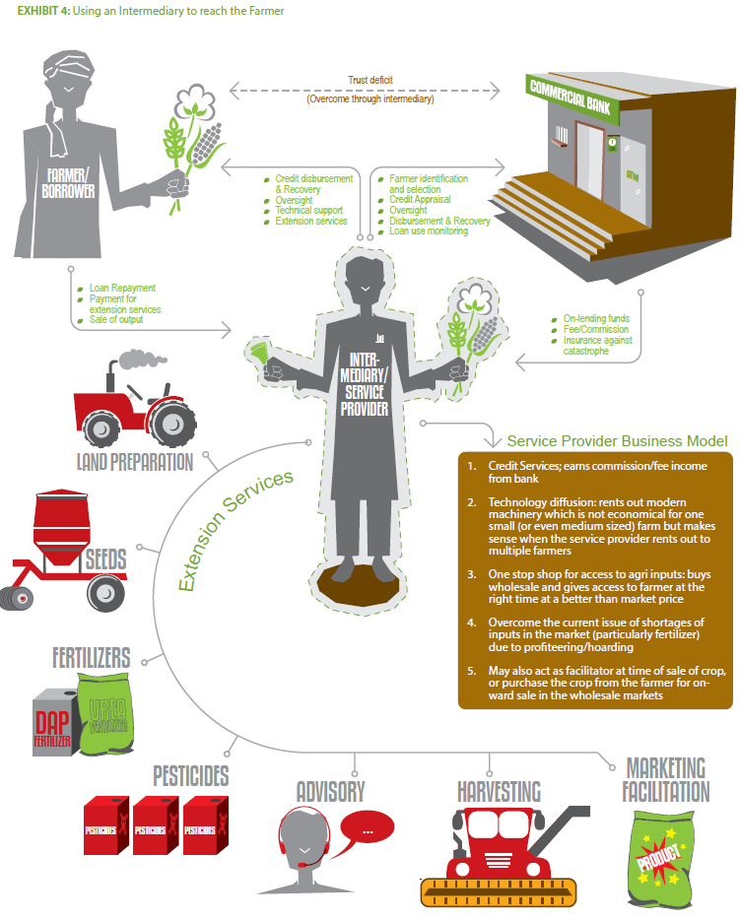
Learning from the Artis; working with them
Using an Intermediary to reach the Farmer
16

Slide 17
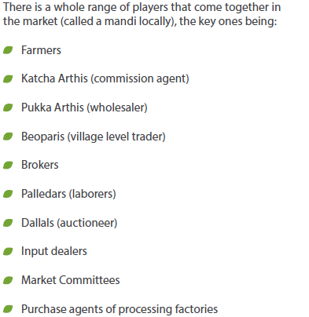
Many players – how do they fit our models?
17

Slide 18
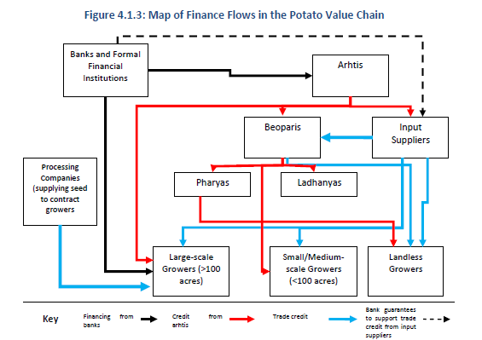
Structuring Finance to Fit the Value Chain
Map of Finance Flows in the Potato Value Chain
18

Slide 19
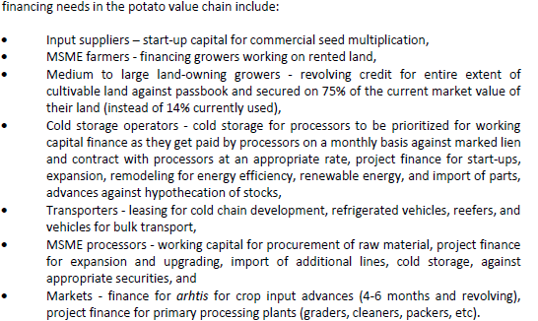
What are the needs of the VC actors?
19

Slide 20
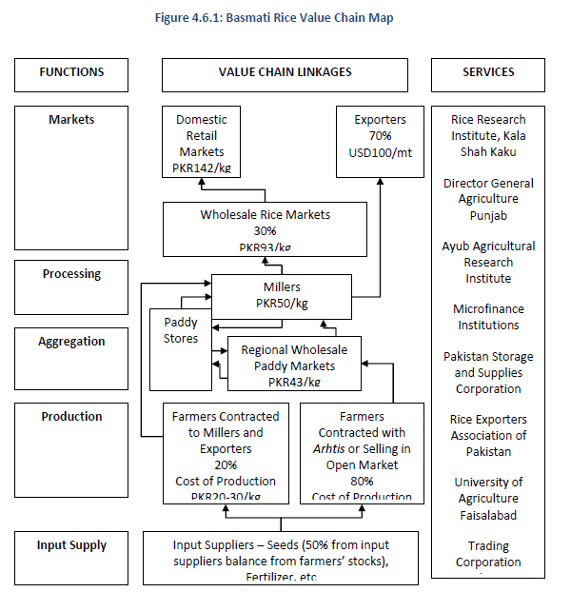
Basmati Rice Value Chain Map
20

Slide 21
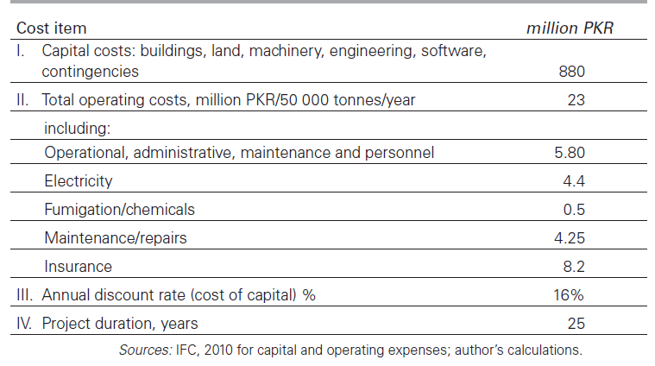
Costs of constructing and operating a 50 000-tonne concrete elevator in Pakistan, 2010
Results of economic analysis of investment in grain elevators in Pakistan, 2010

Slide 22
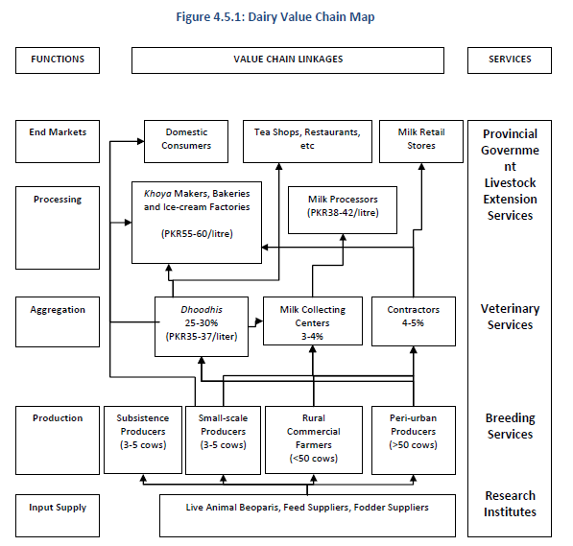
Dairy Value Chain Map
22

Slide 23
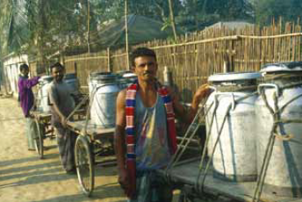
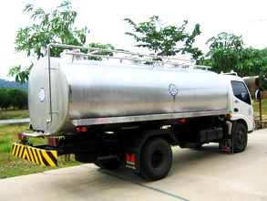
Causes and Prevention of food losses and waste
Poor storage facilities, packaging and lack of infrastructure cause postharvest food losses in developing countries.
Prevention: investment in infrastructure, packaging and transportation.

Slide 24
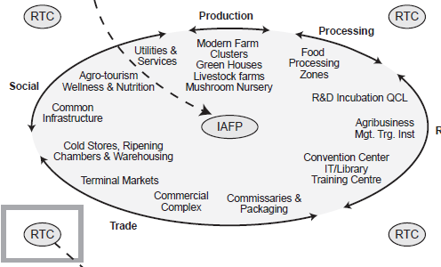
How do we organize for efficiency?
Rural Transformation Centre
Notes:
IAFP = Integrated Agricultural Food Park

Slide 25
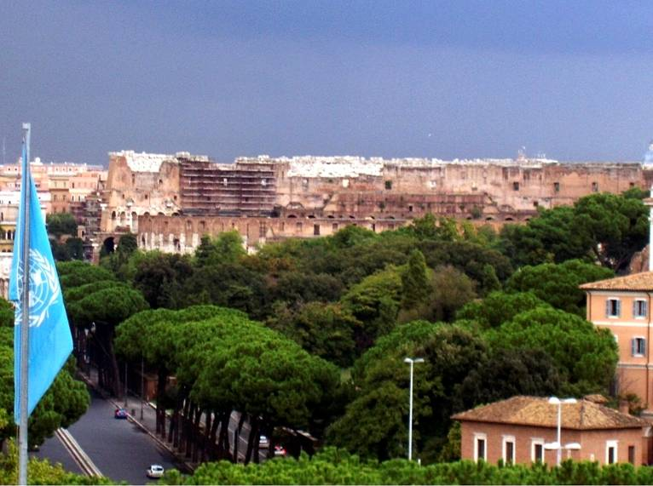
Useful Websites
FAO
www.fao.org/ag/ags
www.ruralfinanceandinvestment.org
Thank You

