Slide 1
Agricultural Value Chain Financing – A strategy towards replacing or complementing conventional financing
Calvin Miller
FAO, Rome, Italy
International Conference on Innovative Agricultural Financing
State Bank of Pakistan and FAO
Islamabad, April 28-29. 2015

Slide 2
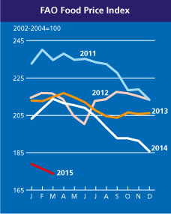
Growing interest in financing agriculture, especially agri-business
Food prices are rising and trend is favourable
Growing attention to food security
Agriculture and technologies are changing offering new opportunities and efficiency for finance and investment

Slide 3
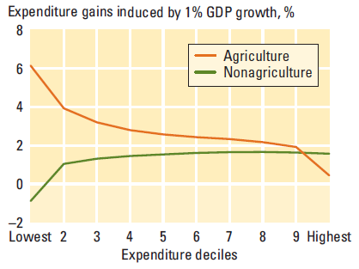
Growing public interest in agriculture
Source: Ligon and Sadoulet, 2007
Growth in the agricultural sector has a stronger positive impact on the poorest compared to growth in the non-agricultural sector
3

Slide 4
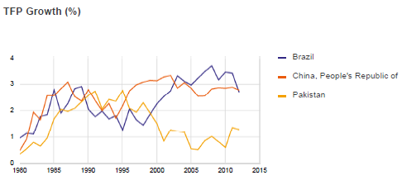
Productivity is lagging – is a lack of finance stunting growth?
Agricultural total factor productivity (TFP) = total output/total production inputs (land, labor, capital and agricultural inputs)
4

Slide 5
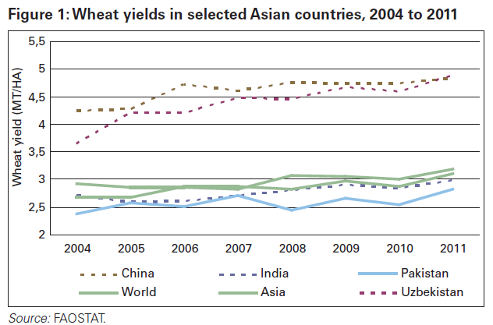
Low yields – is low investment a culprit?
Wheat yields in selected Asian countries, 2004 to 2011
Average wheat yields in Pakistan are below its neighbors despite a high percentage under irrigation
Notes:
Why – productivity is not keeping up due to low inadequate irrigation infrastructure andinsufficient farm inputs.

Slide 6
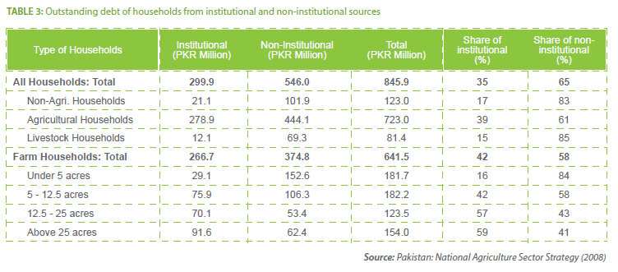
What is the financial situation?
Outstanding debt of households from institutional and non-institutional sources
6

Slide 7
A strong business case for agricultural financing; a need for a new approach to do it
Commercial banks of Pakistan make up over 80 % of the financial sector, yet hardly reach the 61% of farmers with less than 5 acres of land nor the 33% with 5-25 acres.
There is no business case to reach them with conventional banking business models – the business models must adapt.
NIBAF/PMN Arti study
7

Slide 8
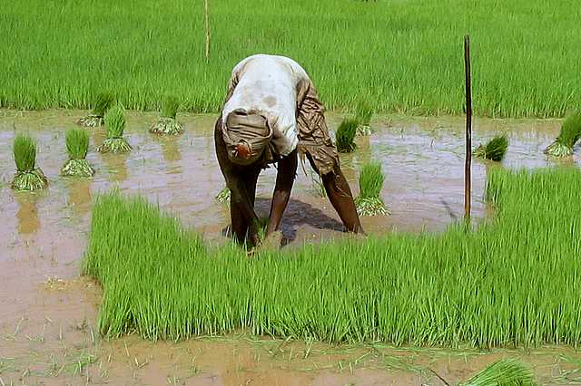
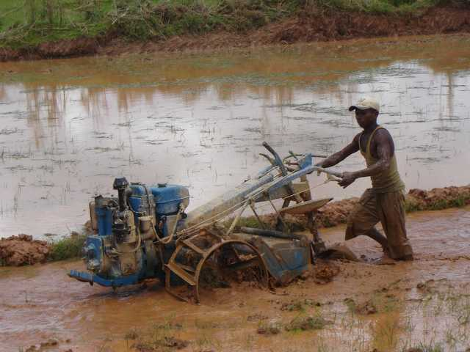
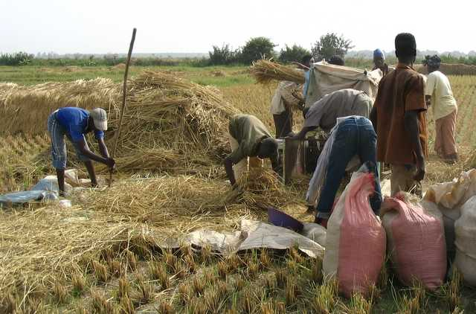
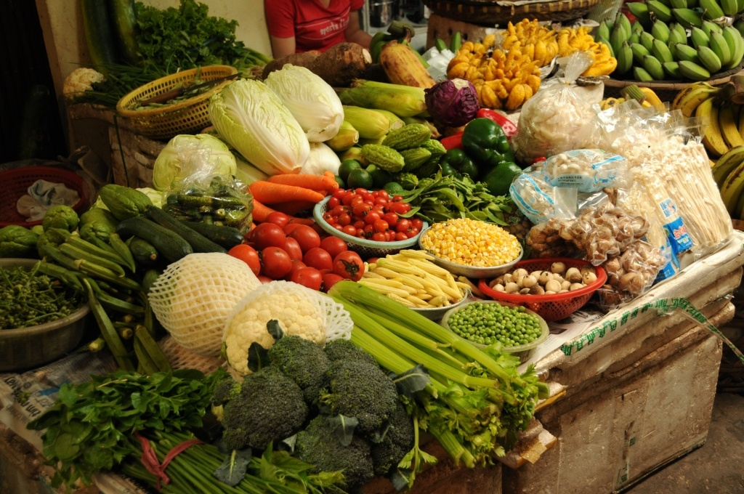
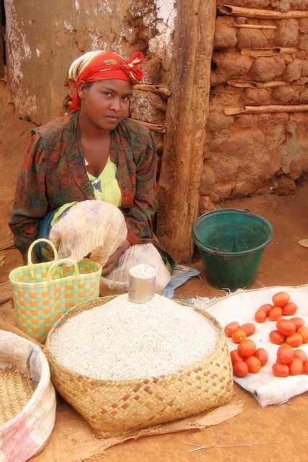
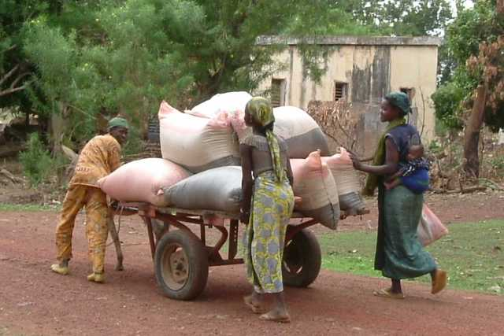
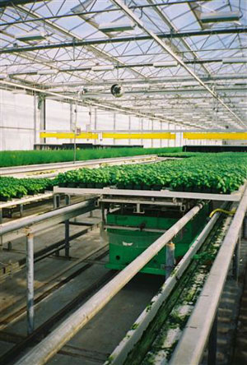
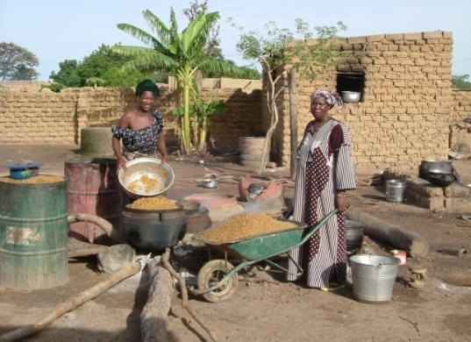
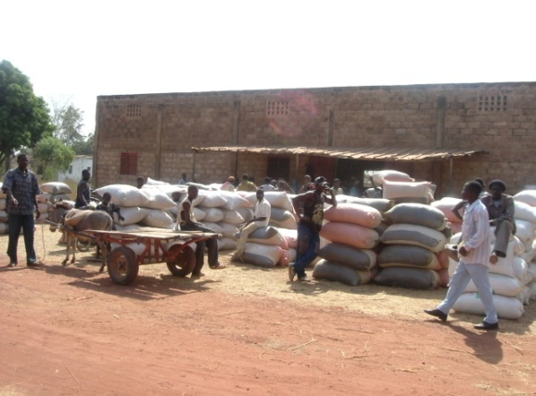
Agri-finance has unique characteristics and stages
8

Slide 9
Overcoming the constraints
Key Challenges for Rural Investment
Vulnerability Constraints
Systemic Risk
Market Risk
Credit Risk
Operational Constraints
Low and slow investment returns (historically)
Low levels of assets and investment
Low levels of knowledge of agricultural lending
9
Notes:
Systemic Risk – rural incomes, especially among the agriculturalists, are highly susceptible to similar risks at the same time. Weather is the most uncontrollable and often devastating risk but disease and plagues are similarly important. Failures in agriculture affect not only the farmer households and the production and marketing linkages but also the rural non-farm economies that revolve around and depend upon those income flows. Even so, the most problematic is farm credit because of higher risk.
Market Risk – especially in developing countries, there both cyclical and seasonal price fluctuations of agricultural commodities, not only due to local production variation but also affected by “outside forces” such as political price and exchange controls, subsidies and globalization.
Credit Risk – collateral, especially mortgage, is a missing element in most rural finance hence increasing the risk of the lender. Similarly collateral substitutes may be costly in both financial terms as well as social stigma risk terms as can be the case with peer lending. Other support services and information networks such as credit bureaus are often not available to help lower the risk. For term lending, a financial gap risk between sources and uses of funds poses another risk constraint.

Slide 10
What is a value chain?
Value chain describes the full range of activities involved in getting a product or service from conception, through the different phases of production, transformation and delivery to the final consumer.
10

Slide 11
Defining agricultural value chain finance
Value chain finance – financial products and services flowing to and/or through a VC to address the needs of those involved in that chain, be it a need for finance, a need to secure sales, procure products, reduce risk and/or improve efficiency within the chain.
Objectives:
Align and structure financial products to fit the chain
Reduce costs and risks of finance
11

Slide 12
What is the difference in approach
AgVCF looks at direct and indirect financing
It analyses the market, the VC, the relationships as well as the client. It identifies the:
Structure of the value chain: all individuals and firms that conduct business by adding value and helping move the product toward the end markets
External framework: the broader national context in which the chain operates
Business model: the dynamics and “drivers” of the value chain, and the individual and firm behaviours and their effect on the functioning of the chain transactions and “buy-in”
Trends and future risks and opportunities in the chain and its participants
12

Slide 13
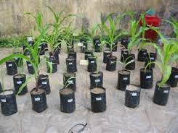
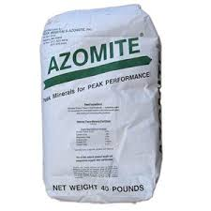
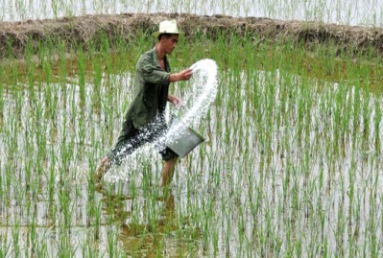
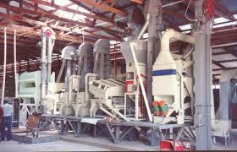
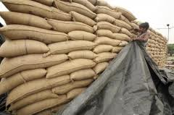
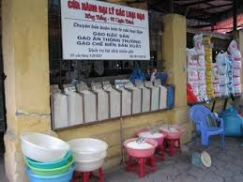
Where do we invest in the AgVC?
Consumer
Input
Supply
Production
Processing
Wholesale
Retail
13

Slide 14
Agricultural Value Chain Finance in context
Does AgVCF replace conventional financing?
No
Does it compete with conventional financing?
No, it complements it?
Does it strengthen conventional financing?
Yes, through a change in mindset; through a knowledge centric approach to tailor fit financing to the client and market context.
14

Slide 15
The agri-value chain approach
AgVCF can be viewed as a series of tools and mechanisms.
This approach is based on a systemic viewpoint, looking at the collective set of actors, processes and markets of the chain as opposed to an individual lender-borrower within the system.
Decisions on AgVCF are based on the health of the entire value chain and not just on the individual borrower.
In AgVC-based finance, knowledge of the agricultural system is required; for conventional financing, the credit-worthiness of the client and business is the primary criteria.
AgVCF focuses more on the payments to be received from activities, such as production and value-added transactions, does is the case for conventional finance.
15

Slide 16
Complements and overlaps of AgVCF
Arti trader finance
Trade finance
Value chain finance
Microfinance
Islamic finance
Savings and deposits
Term finance
Banking services
Mortgage lending
Guarantee funds
Insurance
16

Slide 17
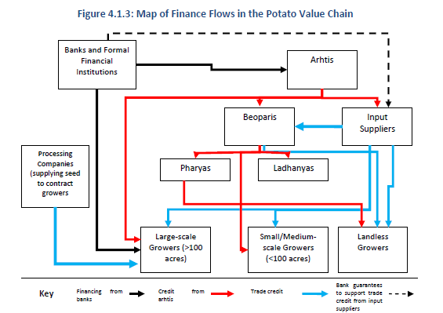
Structuring Finance to Fit the Value Chain
Map of Finance Flows in the Potato Value Chain
17

Slide 18
Commodity finance and marketing
Farm Producers
Crop mix & timing of planting
Accessing finance
Seed & inputs
Harvest
Marketing decisions
Market Institutions
Geographic pricing
Demand/price discovery
Product quality standards
Credit & payment terms
Risk management
Pakistan banks
Artis
Millers
Processing & storage capacity
Inventory levels
Delivery & processing
Procurement plan
Storage Services
Strategic Location
Assured product integrity
Negotiable contracts
Efficient sales lots
Economic market points
Merchants
Pricing
Terms of sale
Distribution channels
Risk sharing
After sale support
Integrate
Integrate
Integrate
Integrate
18

Slide 19
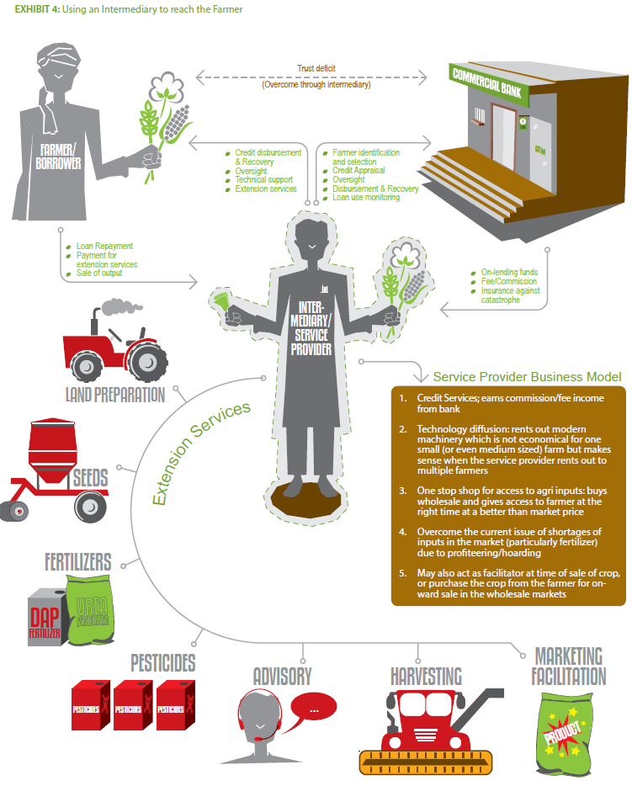
Learning from and working with the Arthis
Using an Intermediary to reach the Farmer
19

Slide 20
Many players – how do they fit our models?
Farmers
Input suppliers
Business and extension service providers
Traders and commission agents
Brokers and market committees
Processing companies
Warehouse and commodity management companies
Wholesale buyers
Exporters
Consumers
Local MFIs and informal financing providers
Mobile phone and ITC service providers
Governmental regulators
20

Slide 21
5 Categories of financing instruments
Category | Financing instrument
Agricultural product based | Trade credit Input supply credit Marketing company credit Lead firm financing / contract farming
Receivable based | Trade receivable finance Bill discounting Factoring and reverse factoring Forfaiting
Physical asset based | Warehouse receipts system Re-purchase agreements Leasing
21

Slide 22
Financing Instruments
Type of product | Financial instrument
Risk mitigation | Insurance Forwards contract Futures
Financial enhancements | Securitization Loan guarantees Joint ventures
There are multiple agricultural value chain financing instruments to consider; often to be used in conjunction with one another.
22

Slide 23
5 Cs and a big C of AgVCF Loan Analysis
Common Cs
Character – the person and family
Capacity – the technical, economic and financial feasibility and past history of the person and enterprise
Capital – the funds invested into the business and other assets vs. debt level
Collateral – the risks and guarantees
Conditions – the loan terms (amount, use, repayment requirements) and market conditions
Big C: Cash and transaction flows
Cash and process flows within the VC and the finance available for transactions as well as VC actors’ household and enterprise expenses, reinvestment and repayment

Slide 24
Ethiopia blended approach to AgVCF Inclusion
Rabobank (guarantee) Rabobank (loans)
Commercial Banks
FAO & Int NGOs
Rabo Advisory
Services
Companies
BDS providers
Terrafina Local NGO
Farmers / groups
MFIs
Adapted from Harms
24

Slide 25
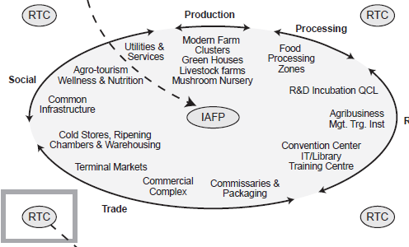
How do we organize for efficiency?
Rural Transformation Centre
Yes Bank, India
25
Notes:
IAFP = Integrated Agricultural Food Park

Slide 26
Key Messages
A value chain perspective helps financiers and service providers to focus on the right services. Key considerations in AgVCF by the financial institutions are:
the strength of the AgVC and its opportunities and challenges;
the business model for AgVCF;
the risks involved in each of the nodes and actors;
the technical, business and financial services and support.
Financial institutions must engage more with value chain actors in order to learn and to co-develop new products and reach new markets.
Many trade finance and Islamic finance products are similar can be adapted for AgVCF
Risk mitigation, using both financial and non-financial tools, is a critical element
AgVCF is a comprehensive knowledged-based approach to lending
Inclusive agricultural financing is profitable with the right approach
Capacity and organizational development support from the public sector may be needed before financing small producers
26

Slide 27
Useful Websites
FAO
www.fao.org/ag/ags
www.ruralfinanceandinvestment.org
Thank You

