Slide 1
Session B: Digital platforms in building data-systems for agri-finance 28 April 2015, 16:00-17:00
Moderator: Ralph Houtman (3 mins)
Presentors:
Mr. Muhammad Iftekhar Bhatti, GM, SUPARCO
Mr. John Amimo, AFRACA
Mr. Hamza Matin, CEO, EDP Services Ltd.
Mr. Syed Mohsin Ahmed, CEO, Pakistan Microfinance Network

Slide 2
FAO-GIZ MicroBanker System (www.mbwin.net) A software for rural banking and microfinance institutions including group schemes and with certain sharia features, web-based reporting GRECOCOS (www.grecocos.org) A web-based logistics tool for direct marketing of (fresh) produce to consumer groups, located near a “collection point” FOLLOWMEE (www.followmee.com): GPS tracker to keep track of your staff in the field; needs smartphone for staff; free for basic version GOOGLE Maps (yet to be implemented): Map interface to be used linking buyers/consumers to groups of PGS certified farmers; free for basic usage

Slide 3
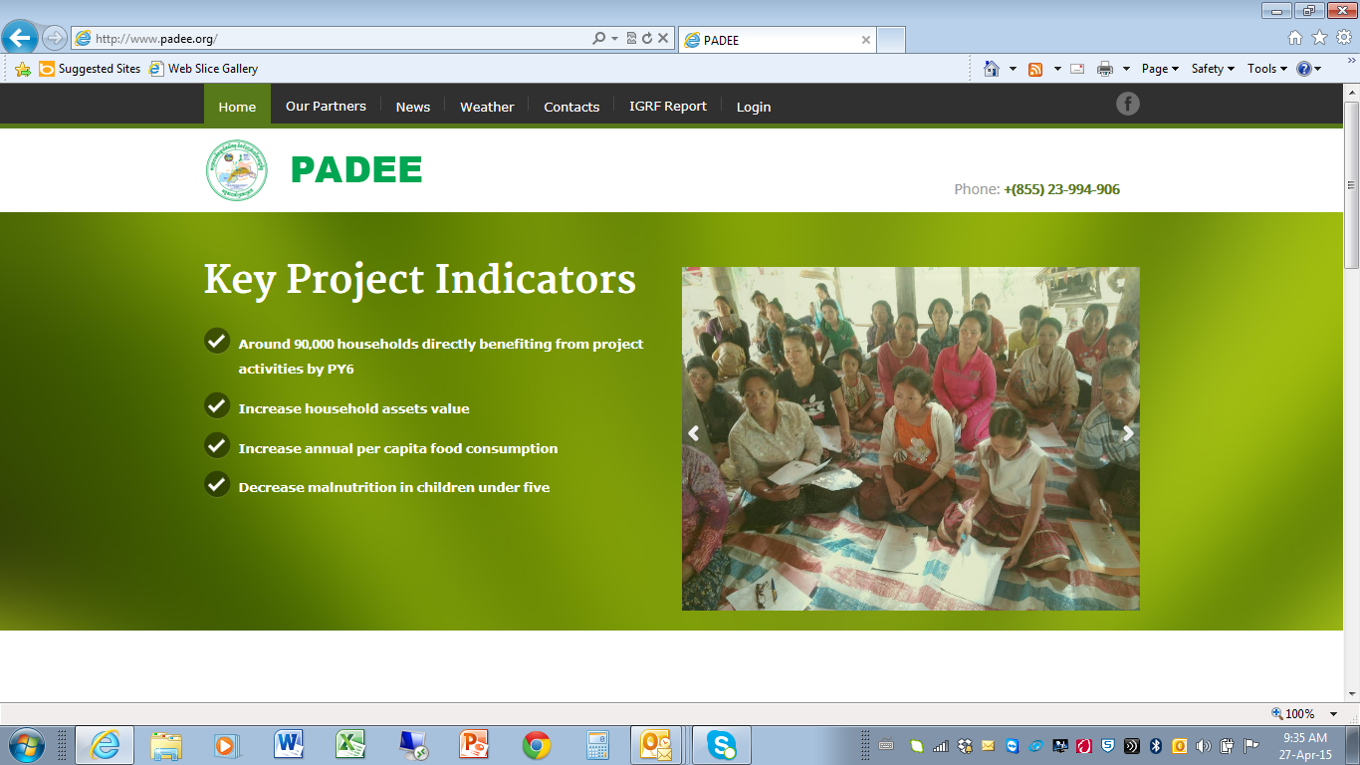
Login: reporter
Password: reporter

